Slide 1
Chapter 3
Molecules, Compounds, and Chemical Equations

Slide 2
How Many Different Substances Exist?
Elements combine with each other to form compounds.
The great diversity of substances that we find in nature is a direct result of the ability of elements to form compounds.

Slide 3
Hydrogen, Oxygen, and Water
The dramatic difference between the elements hydrogen and oxygen and the compound water is typical of the differences between elements and the compounds that they form.
When two or more elements combine to form a compound, an entirely new substance results.

Slide 4
Hydrogen, Oxygen, and Water
Selected Property | Hydrogen | Oxygen | Water
Boiling Point (degrees celsius) | -253 | -183 | 100
State at Room Temperature | Gas | Gas | Liquid
Flammability | Explosive | Necessary for Combustion | Used to extinguish flame

Slide 5
Mixtures and Compounds
In a mixture, elements can mix in any proportions whatsoever (hydrogen, H₂, and oxygen, O₂).
In a compound, elements combine in fixed, definite proportions (water, H₂O).

Slide 6
Definite Proportion
A hydrogen–oxygen mixture can have any proportions of hydrogen and oxygen gas.
Water, by contrast, is composed of water molecules that always contain two hydrogen atoms to every one oxygen atom.
Water has a definite proportion of hydrogen to oxygen.

Slide 7
Chemical Bonds
Compounds are composed of atoms held together by chemical bonds.
Chemical bonds result from the attractions between the charged particles (the electrons and protons) that compose atoms.
Chemical bonds are broadly classified into two types:
ionic and
covalent.

Slide 8
Ionic Bonds
Ionic bonds, which occur between metals and nonmetals, involve the transfer of electrons from the metal atom to the
nonmetal atom.
The metal atom then becomes a cation while the nonmetal atom becomes an anion.
These oppositely charged ions attract one another by electrostatic forces and form an ionic bond.

Slide 9
Ionic Compounds in Solid Phase
In the solid phase, the ionic compound is composed of a lattice—a regular three-dimensional array—of alternating cations
and anions.

Slide 10
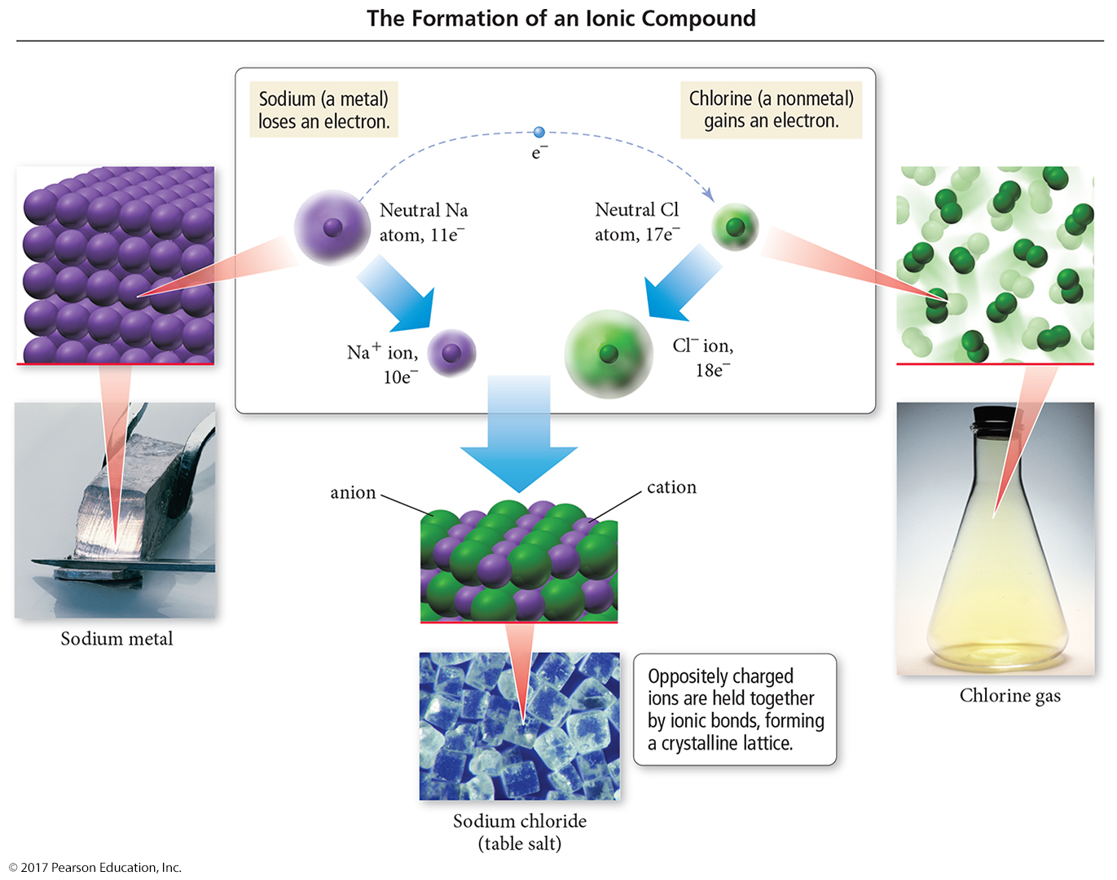
The Formation of Ionic Compounds

Slide 11
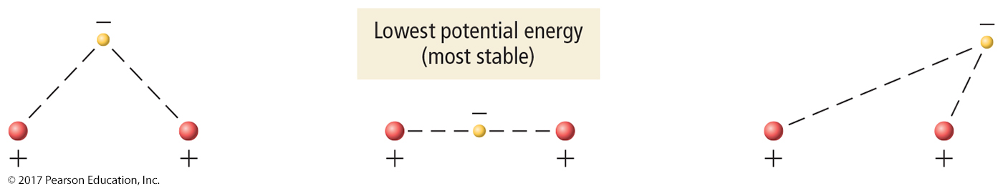
Covalent Bonds
Covalent bonds occur between two or more nonmetals. The two atoms share electrons between them, composing a molecule.
Covalently bonded compounds are also called molecular compounds.

Slide 12
Types of Chemical Formulas
An empirical formula gives the relative number of atoms of each element in a compound.
A molecular formula gives the actual number of atoms of each element in the molecule of a compound.
(a) For H₂O₂, the greatest common factor is 2. The
empirical formula is therefore HO.
(b) For B₂H₆, the greatest common factor is 2. The
empirical formula is therefore BH₃.
(c) For CCl₄, the only common factor is 1, so the empirical
formula and the molecular formula are identical.

Slide 13
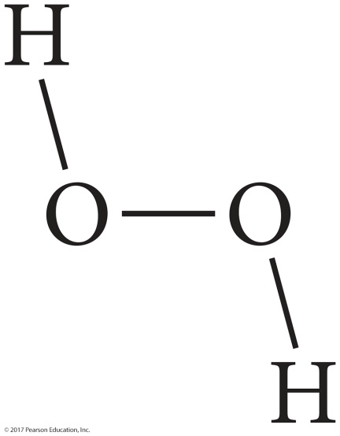

Types of Chemical Formulas
A structural formula uses lines to represent covalent bonds and shows how atoms in a molecule are connected or bonded to each other.
It can also show the molecule’s geometry.
The structural formula for H₂O₂ can be shown as either of the following.

Slide 14
Types of Chemical Formulas
The type of formula we use depends on how much we know about the compound and how much we want to communicate.
A structural formula communicates the most information. An empirical formula communicates the least.

Slide 15
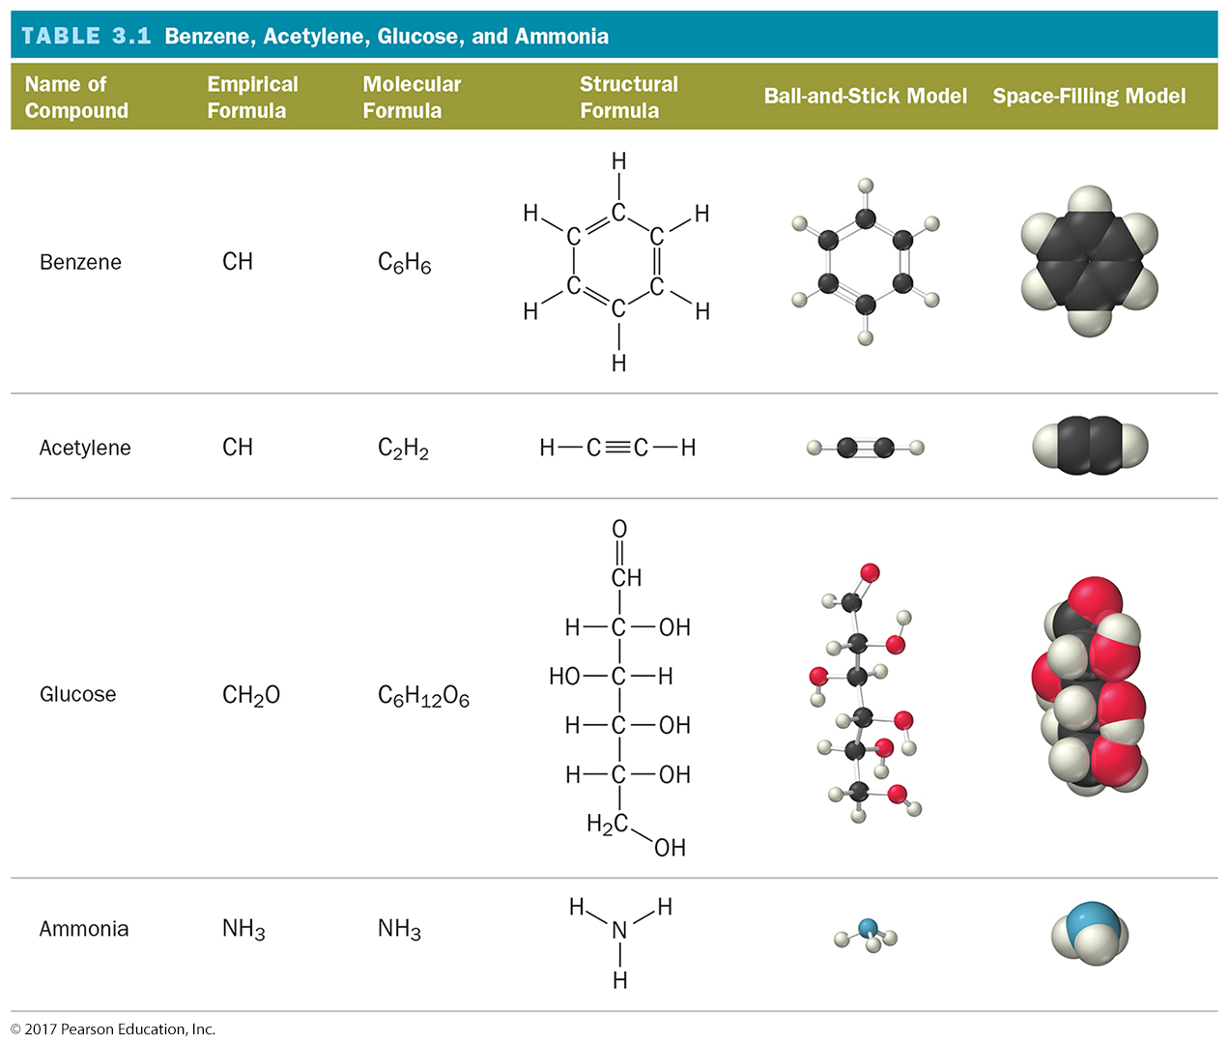
Ways of Representing a Compound

Slide 16
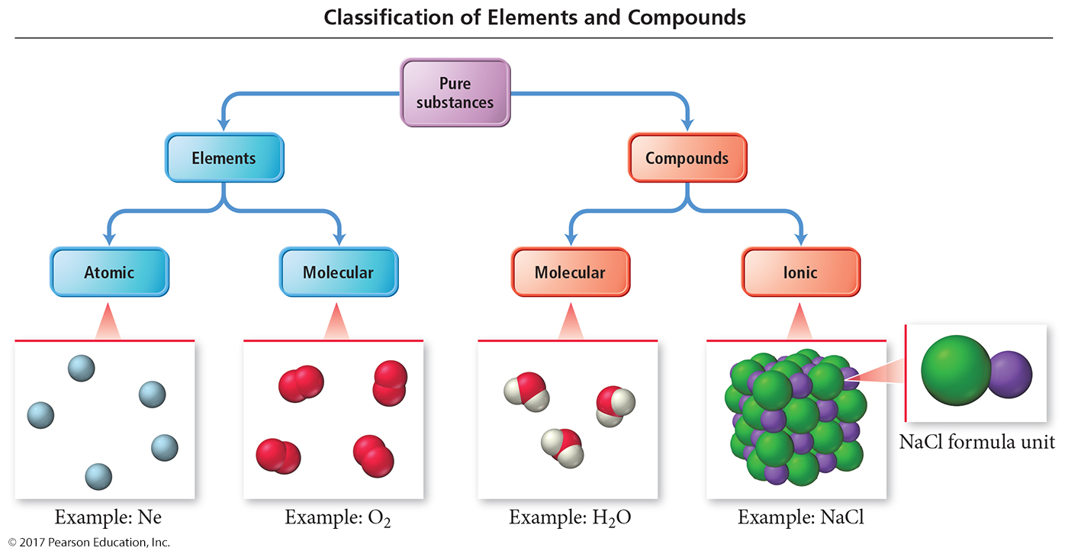
An Atomic-Level View of Elements and Compounds
Elements may be either atomic or molecular.
Compounds may be either molecular or ionic.

Slide 17
View of Elements and Compounds
Atomic elements exist in nature with single atoms as their basic units. Most elements fall into this category.
Examples are Na, Ne, K, Mg, etc.
Molecular elements do not normally exist in nature with single atoms as their basic units; instead, they exist as molecules—two or more atoms of the element bonded together.
There are only seven diatomic elements and they are H₂, N₂, O₂, F₂, Cl₂, Br₂, and I₂.
Also, P₄ and S₈ are polyatomic elements.

Slide 18
Molecular Compounds
Molecular compounds are usually composed of two or more covalently bonded nonmetals.
The basic units of molecular compounds are molecules composed of the constituent atoms.

Slide 19
Ionic Compounds
Ionic compounds are composed of cations (usually a metal) and anions (usually one
or more nonmetals) bound together by
ionic bonds.
The basic unit of an ionic compound is the formula unit, the smallest, electrically neutral collection of ions.
There is no such thing as an ionic molecule!!!

Slide 20
Polyatomic Ions
Many common ionic compounds contain ions that are themselves composed of a group of covalently bonded atoms with an overall charge.
This group of charged species is called polyatomic ions.
NaNO₃ contains Na⁺ and NO₃–.
CaCO₃ contains Ca²⁺ and CO₃^{2–}.
Mg(ClO₃)₂ contains Mg²⁺ and ClO₃–.

Slide 21
Ionic Compounds: Formulas and Names
Summarizing Ionic Compound Formulas
Ionic compounds always contain positive and negative ions.
In a chemical formula, the sum of the charges of the cations must equal the sum of the charges of the anions.
The formula of an ionic compound reflects the smallest whole-number ratio of ions.
Never referred to as a molecule!

Slide 22
Ionic Compounds: Formulas and Names
The charges of the representative elements can be predicted from their group numbers.
The representative elements form only one type of charge.
Transition metals tend to form multiple types of charges.
Hence, their charges cannot be predicted as in the case of most representative elements.

Slide 23
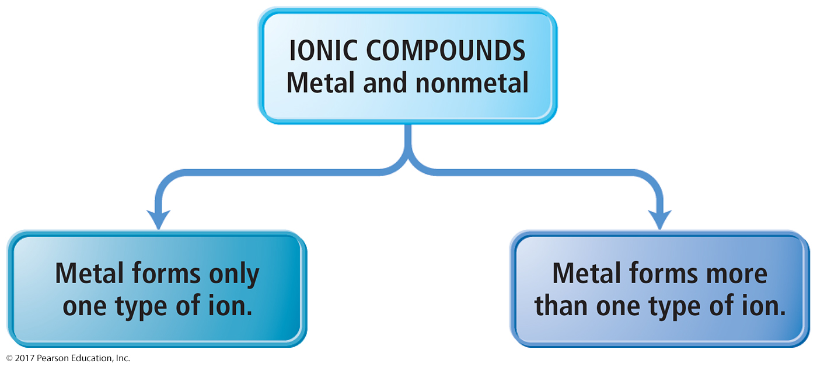
Naming Ionic Compounds
Ionic compounds can be categorized into two types, depending on the metal in the compound.
Type I
Type II

Slide 24
Naming Type I Ionic Compounds
Type I ionic compounds contain a metal whose charge is invariant from one compound to another when bonded with a nonmetal anion.
The metal ion always has the same charge.

Slide 25
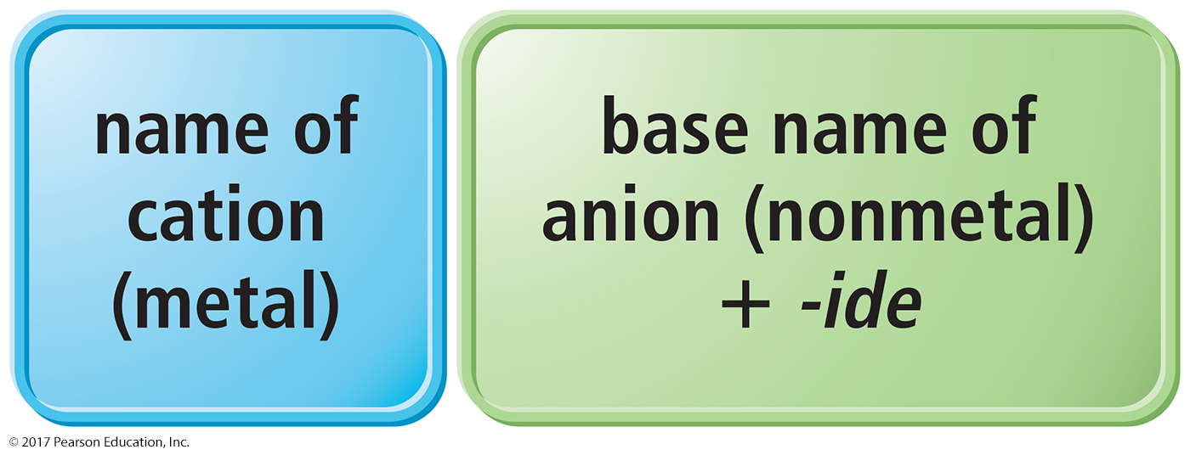
Naming Binary Ionic Compounds of Type I Cations
Binary compounds contain only two different elements. The names of binary ionic compounds take the following form:

Slide 26
Examples: Type I Binary Ionic Compounds
The name for KCl consists of the name of the cation, potassium, followed by the base name of the anion, chlor, with the
ending -ide.
KCl is potassium chloride.
The name for CaO consists of the name of the cation, calcium, followed by the base name of the anion, ox, with the ending -ide.
CaO is calcium oxide.

Slide 27
Naming Type II Ionic Compounds
The second type of ionic compound contains a metal that can form more than one kind of cation, depending on the compound, bonded to a nonmetal anion.
The metal’s charge must be specified for a given compound.
The proportion of metal cation to nonmetal anion helps us determine the charge on the metal ion.

Slide 28
Type II Ionic Compounds
Iron, for instance, forms a 2+ cation in some of its compounds and a 3+ cation in others.
Metals of this type are often transition metals.
FeS: Here, iron is +2 cation (Fe²⁺).
Fe₂S₃: Here, iron is +3 cation (Fe³⁺).
Cu₂O: Here, copper is +1 cation (Cu⁺).
CuO: Here, copper is +2 cation (Cu²⁺).
Some main group metals, such as Pb, Ti, and Sn, form more than one type of cation.

Slide 29
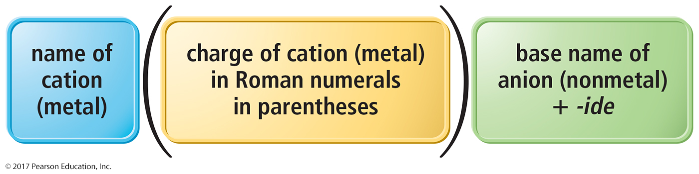
Naming Type II Binary Ionic Compounds
The full name of compounds containing metals that form more than one kind of cation have the following form:
The charge of the metal cation can be determined by inference from the sum of the charges of the nonmetal.

Slide 30
Naming Type II Binary Ionic Compounds
For these types of metals, the name of the cation is followed by a roman numeral (in parentheses) that indicates the charge of the metal in that particular compound.
For example, we distinguish between Fe²⁺ and Fe³⁺ as follows:
Fe²⁺ Iron(II)
Fe³⁺ Iron(III)

Slide 31
Example: Type II Binary Ionic Compounds
To name CrBr₃,determine the charge on the chromium.
Total charge on cation + total anion charge = 0.
Cr charge + 3(Br– charge) = 0.
Since each Br has a –1 charge, then:
  Cr charge + 3(–1) = 0.
  Cr charge –3 = 0.
  Cr = +3.
Hence, the cation Cr³⁺ is called chromium(III), while Br– is called bromide.
Therefore, CrBr₃ is chromium(III) bromide.

Slide 32
Naming Ionic Compounds Containing Polyatomic Ions
We name ionic compounds that contain a polyatomic ion in the same way as other ionic compounds, except that we use the name of the polyatomic ion whenever it occurs.
For example, NaNO₂ is named according to its cation, Na⁺, sodium, and its polyatomic anion, NO₂–, nitrite.
Hence, NaNO₂ is sodium nitrite.

Slide 33
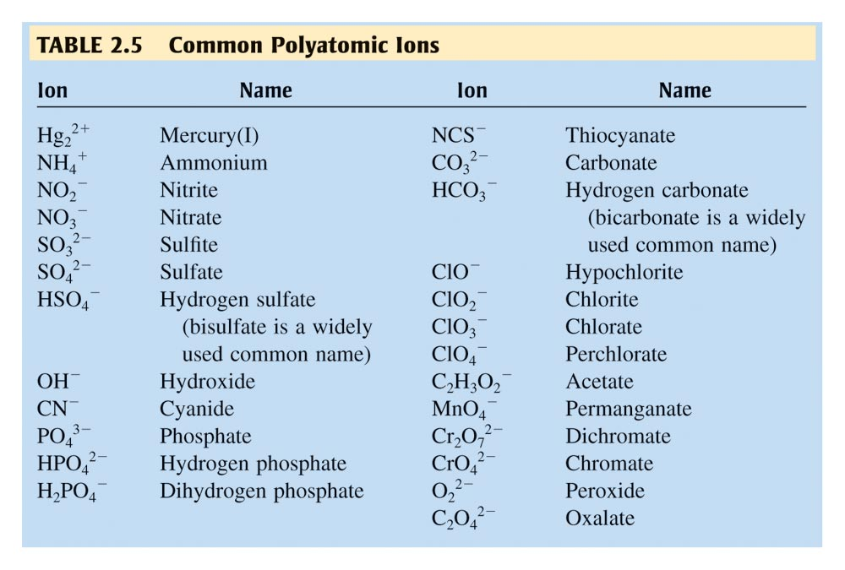
Know this List!!!

Slide 34
Oxyanions
Most polyatomic ions are oxyanions, anions containing oxygen and another element.
Notice that when a series of oxyanions contains different numbers of oxygen atoms, they are named according to the number of oxygen atoms in the ion.
If there are two ions in the series,
the one with more oxygen atoms has the ending -ate, and
the one with fewer has the ending -ite.
For example,
NO₃– is nitrate.
SO₄^{2–} is sulfate.
NO₂– is nitrite.
SO₃^{2–} is sulfite.

Slide 35
Oxyanions
If there are more than two ions in the series, then the prefixes hypo-, meaning less than, and per-, meaning more than, are used.
ClO– hypochlorite BrO– hypobromite
ClO₂– chlorite BrO₂– bromite
ClO₃– chlorate BrO₃– bromate
ClO₄– perchlorate BrO₄– perbromate

Slide 36
Hydrated Ionic Compounds
Hydrates are ionic compounds containing a specific number of water molecules associated with each formula unit.
For example, the formula for epsom salts is MgSO₄ • 7H₂O.
Its systematic name is magnesium sulfate heptahydrate.
CoCl₂ • 6H₂O is cobalt(II) chloride hexahydrate.

Slide 37
Common Hydrate Prefixes
Common hydrate prefixes
hemi = ½ tri = 3 hexa = 6
mono = 1 tetra = 4 hepta = 7
di = 2 penta = 5 octa = 8
Other common hydrated ionic compounds and their names are as follows:
  CaSO₄ • ½ H₂O is called calcium sulfate hemihydrate.
  BaCl₂ • 6H₂O is called barium chloride hexahydrate.
  CuSO₄ • 6H₂O is called copper(II) sulfate hexahydrate.

Slide 38
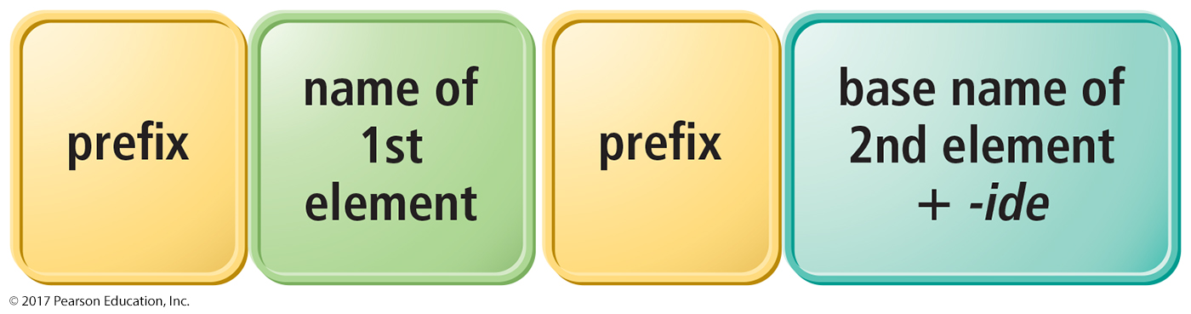
Binary Molecular Compounds
These prefixes are the same as those used in naming hydrates:
mono = 1 hexa = 6
di = 2 hepta = 7
tri = 3 octa = 8
tetra = 4 nona = 9
penta = 5 deca = 10
If there is only one atom of the first element in the formula, the prefix mono- is normally omitted.

Slide 39
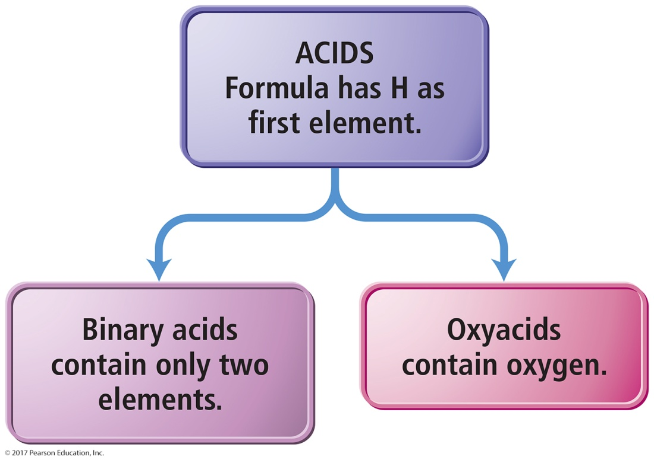
Acids
Binary acids have H⁺ cation and nonmetal anion.
Oxyacids have H⁺ cation and polyatomic anion.

Slide 40
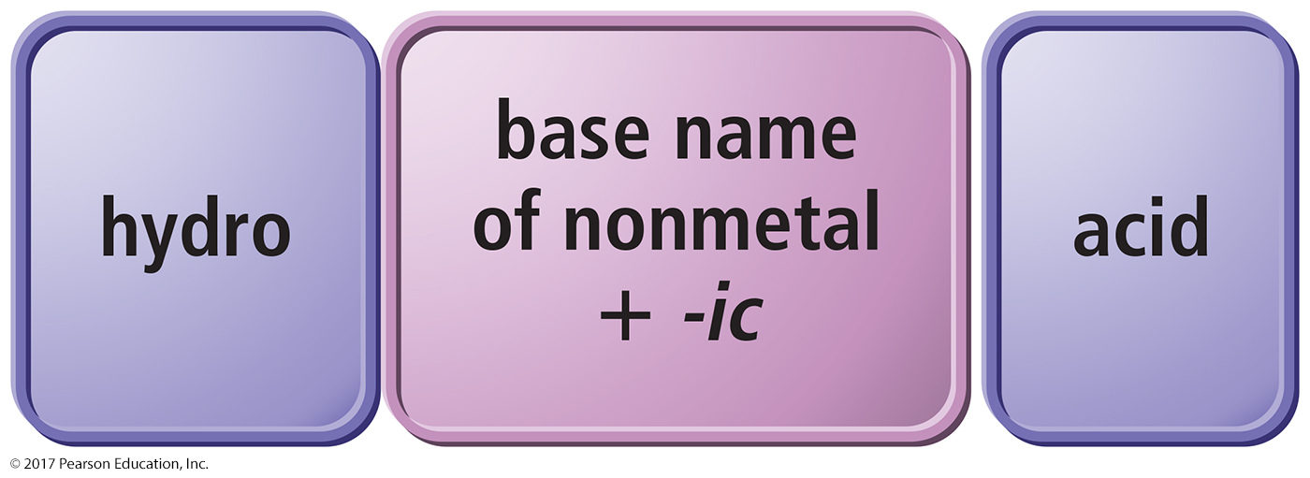
Naming Binary Acids
Write a hydro- prefix.
Follow with the nonmetal base name.
Add –ic.
Write the word acid at the end of the name.

Slide 41
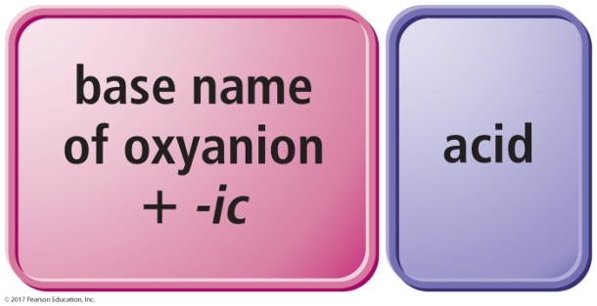
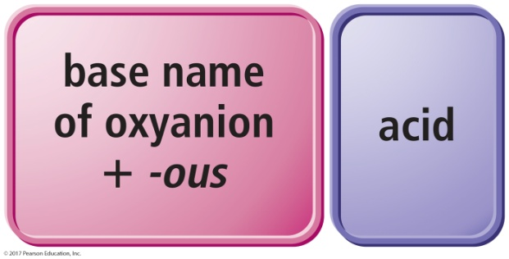
Naming Oxyacids
If the polyatomic ion name ends in –ate, change ending to –ic.
If the polyatomic ion name ends in –ite, change ending to –ous.
Write word acid at the end of all names.
oxyanions ending with -ate
oxyanions ending with -ite

Slide 42
Practice: Name the Acid
1. H₂S
2. HClO
3. HC₂H₃O₂

Slide 43
Practice: Name the Acid
1. H₂S hydrosulfuric acid
2. HClO hypochlorous acid
3. HC₂H₃O₂ acetic acid

Slide 44
Writing Formulas for Acids
When the name ends in acid, the formula starts with H followed by an anion.
Write the formula as if it is ionic, even though it is molecular.
Hydro- prefix means it is binary acid; no prefix means it is an oxyacid.
For an oxyacid,
if the ending is –ic, the polyatomic ion ends
in –ate.
if the ending is –ous, the polyatomic ion ends
in –ous.

Slide 45
For oxyacids
I –ate something –icky and got acid-ite-ous

Slide 46
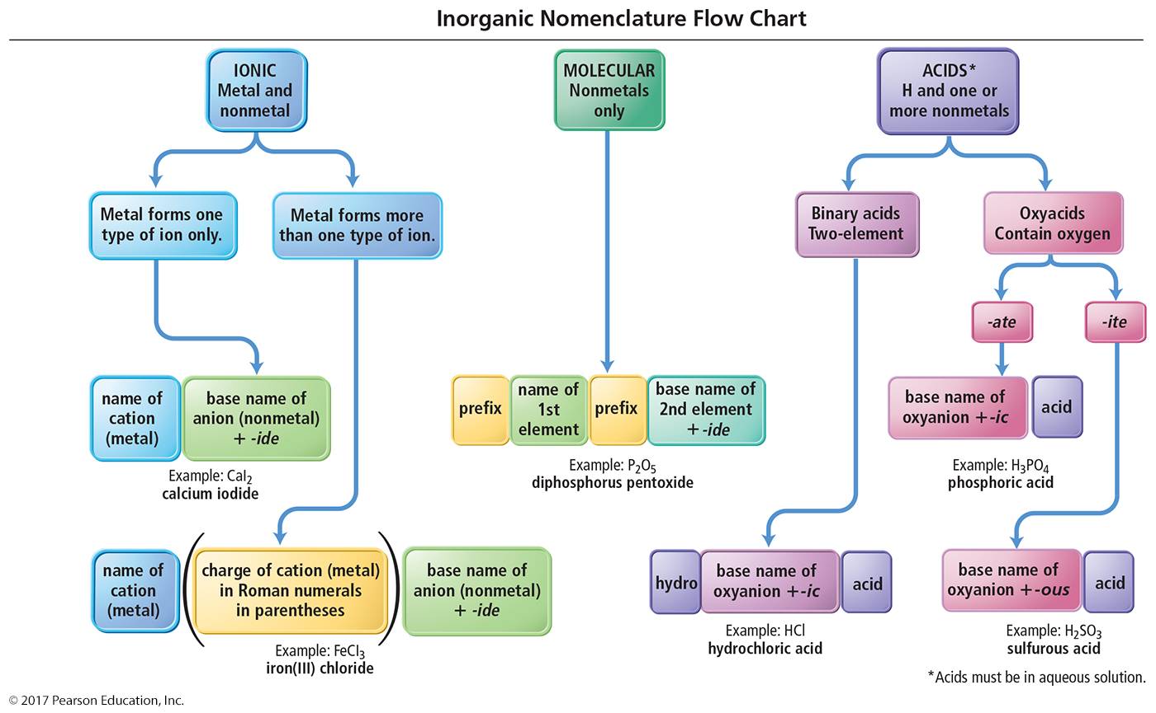
Inorganic Nomenclature Flow Chart

Slide 47
Molar Mass of Compounds
The molar mass of a compound—the mass, in grams, of 1 mol of its molecules or formula units—is numerically equivalent to its formula mass with units of g/mol.

Slide 48
Molar Mass of Compounds
The relative masses of molecules can be calculated from atomic masses:
formula mass = 1 molecule of H₂O = 2(1.01 amu H) + 16.00 amu O = 18.02 amu
1 mole of H₂O contains 2 moles of H and 1 mole
of O:
molar mass = 1 mole H₂O
= 2mol(1.01 g/1 mol H) + 1mol(16.00 g/1 mol O) = 18.02 g/1 mol H₂O
So the molar mass of H₂O is 18.02 g/mole.
Molar mass = formula mass (in g/mole)

Slide 49

Using Molar Mass to Count Molecules by Weighing
Molar mass in combination with Avogadro’s number can be used to determine the number of atoms in a given mass of the element.
Use molar mass to convert to the amount in moles. Then use Avogadro’s number to convert to number of molecules.

Slide 50
Percent Composition
Mass percent of an element:
For iron in iron (III) oxide, (Fe₂O₃)

Slide 51
Formulas
molecular formula = (empirical formula)_{n} [n = integer]
molecular formula = C₆H₆ = (CH)₆
empirical formula = CH

Slide 52
Finding empirical Formulas
100g sample
Molar mass
Percent composition→mass composition→mole
composition→mole ratio→empirical formula
Make subscipts whole #’s
Divide by smallest #

Slide 53
Molecular Formulas
To determine the molecular formula from the empirical formula, divide the given molecular mass by the molecular mass of the empirical formula
  You must be given the actual molecular mass
Acetylene has an empirical formula of CH. The experimentally determined molar mass is 26.04. What is the molar mass of acetylene?
  26.04g/mol = 2.00
  13.02g/mol
  The empirical formula then gets multiplied by 2
  C₂H₂

Slide 54
Determine the empirical and molecular formulas for a compound that gives the following percentages upon analysis: 71.65%Cl, 24.27% C, and 4.07%H. The molar mass is found to be 98.96g/mol

Slide 55
If you have a 100g sample then 71.65%Cl would be 71.6gCl so

Slide 56
Molecular formula

Slide 57
Example 2: A white powder is found to contain 43.64%phosphorus and 56.36% oxygen by mass. The compound has a molecular mass of 283.88g/mol, what are the empirical and molecular formulas?
Example 3: Caffeine contains 49.48%carbon, 5.15% hydrogen, 28.87% nitrogen, and 16.49% oxygen by mass and has a molar mass of 194.2g/mol. Determine the molecular formula of caffeine

Slide 58
Example 2: A white powder is found to contain 43.64%phosphorus and 56.36% oxygen by mass. The compound has a molecular mass of 283.88g/mol, what are the empirical and molecular formulas?
  P₂O₅ and P₄O₁₀
Example 3: Caffeine contains 49.48%carbon, 5.15% hydrogen, 28.87% nitrogen, and 16.49% oxygen by mass and has a molar mass of 194.2g/mol. Determine the molecular formula of caffeine
  C₄H₅N₂O and C₈H₁₀N₄O₂

Slide 59

Chemical Reactions
Reactions involve chemical changes in matter resulting in new substances.
Reactions involve rearrangement and exchange of atoms to produce new molecules.
Elements are not transmuted during a reaction.
Reactants Products

Slide 60
Chemical Equations
Shorthand way of describing a reaction
Provide information about the reaction
Formulas of reactants and products
States of reactants and products
Relative numbers of reactant and product molecules that are required can be used to determine weights of reactants used and products that can be made

Slide 61
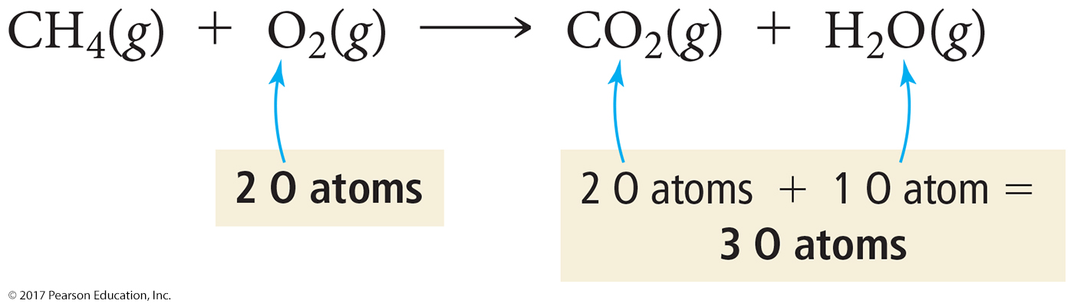
Combustion of Methane
Methane gas burns to produce carbon dioxide gas and gaseous water.
Whenever something burns it combines with O₂(g).
CH₄(g) + O₂(g) → CO₂(g) + H₂O(g)
If you look closely, you should immediately spot a problem.

Slide 62
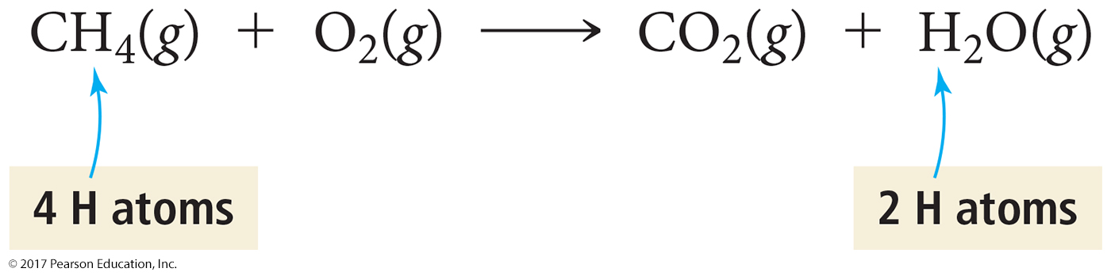
Combustion of Methane
Notice also that the left side has four hydrogen atoms while the right side has
only two.
To correct these problems, we must balance the equation by changing the coefficients, not the subscripts.

Slide 63
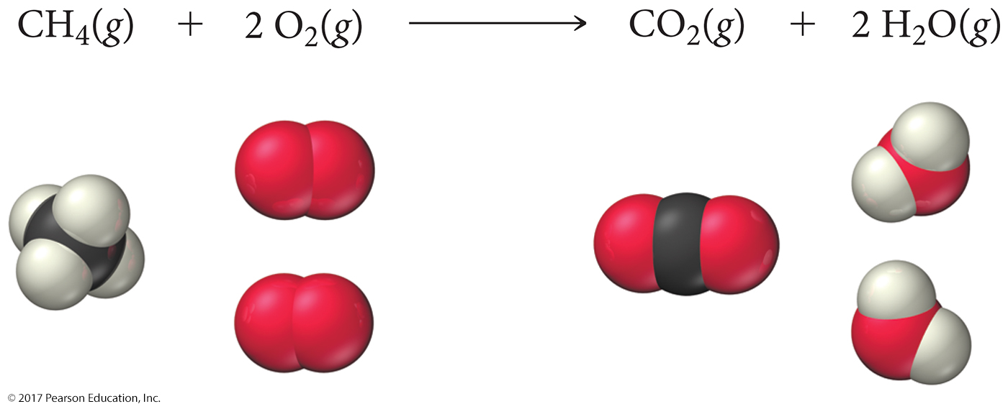
Combustion of Methane: Balanced
To show that the reaction obeys the Law of Conservation of Mass, the equation must be balanced.
We adjust the numbers of molecules so there are equal numbers of atoms of each element on both sides of the arrow.

