Slide 1
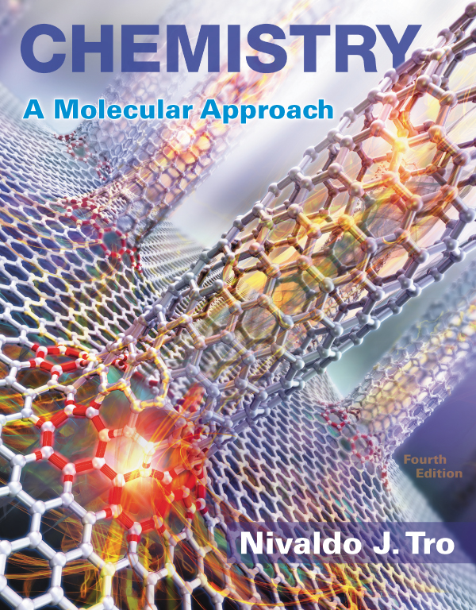
Lecture Presentation
Chapter 2
Atoms and Elements

Slide 2
If You Cut a Piece of Graphite
If you cut a piece of graphite from the tip of a pencil into smaller and smaller pieces, how far could you go? Could you divide it forever?
Cutting the graphite from a pencil tip into smaller and smaller pieces (far smaller than the eye could see) would eventually yield individual carbon atoms.

Slide 3
If You Cut a Piece of Graphite
The word atom comes from the Greek atomos, meaning “indivisible.”
You cannot divide a carbon atom into smaller pieces and still have carbon.
Atoms compose all ordinary matter: If you want to understand matter, you must begin by understanding atoms.

Slide 4
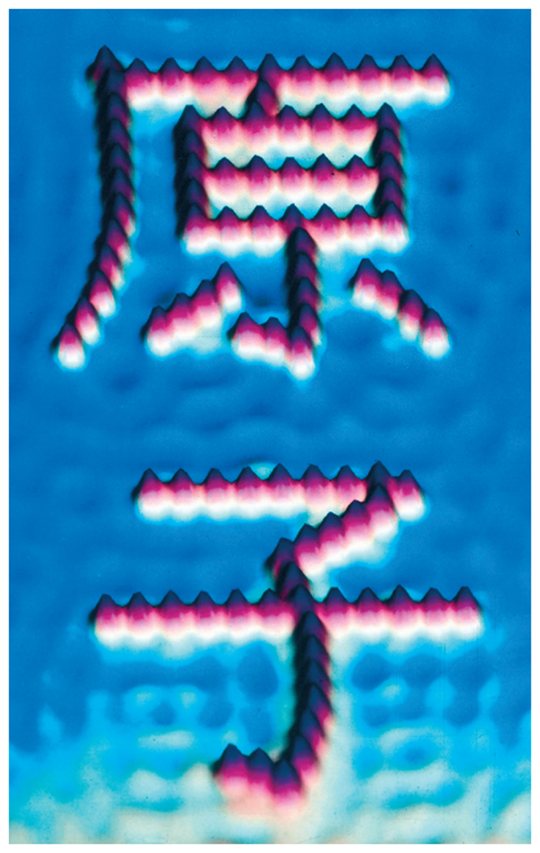
Imaging and Moving Individual Atoms
Scanning tunneling microscopy (STM) is a technique that can image, and even move, individual atoms and molecules.
The image below, obtained by STM, shows iron atoms (red) on a copper surface (blue).

Slide 5
Imaging and Moving Individual Atoms
In spite of their small size, atoms are the key to connecting the macroscopic and microscopic worlds.
An atom is the smallest identifiable unit of an element.
There are about
      91 different, naturally occurring elements, and
      over 20 synthetic elements (elements not found
      in nature).

Slide 6
Early Building Blocks of Matter Ideas
Later, the scientific approach became the established way to learn about the physical world.
An English chemist, John Dalton (1766–1844), offered convincing evidence that supported the early atomic ideas of Leucippus and Democritus.

Slide 7
Modern Atomic Theory and the Laws That Led to It
The theory that all matter is composed of atoms grew out of observations and laws.
The three most important laws that led to the development and acceptance of the atomic theory were
  the law of conservation of mass,
  the law of definite proportions, and
  the law of multiple proportions.

Slide 8
The Law of Conservation of Mass
Antoine Lavoisier formulated the law of conservation of mass, which states that in a chemical reaction, matter is neither created nor destroyed.
Hence, when a chemical reaction occurs, the total mass of the substances involved in the reaction does not change.

Slide 9
The Law of Definite Proportions
In 1797, a French chemist, Joseph Proust, made observations on the composition of compounds.
He summarized his observations in the law of definite proportions.
  All samples of a given compound, regardless of their source or how they were prepared, have the same proportions of their constituent elements.

Slide 10

The Law of Definite Proportions
The law of definite proportions is sometimes called the law of constant composition.
    For example, the decomposition of 18.0 g of water results in 16.0 g of oxygen and 2.0 g of hydrogen, or an oxygen-to-hydrogen mass ratio of the following:

Slide 11
The Law of Multiple Proportions
In 1804, John Dalton published his law of multiple proportions.
  When two elements (call them A and B) form two different compounds, the masses of element B that combine with 1 g of element A can be expressed as a ratio of small whole numbers.
An atom of A combines with either one, two, three, or more atoms of B (AB₁, AB₂, AB₃, etc.).

Slide 12
The Law of Multiple Proportions
Carbon monoxide and carbon dioxide are two compounds composed of the same two elements: carbon and oxygen.
  The mass ratio of oxygen to carbon in carbon dioxide is 2.67:1; therefore, 2.67 g of oxygen reacts with 1 g of carbon.
  In carbon monoxide, however, the mass ratio of oxygen to carbon is 1.33:1, or 1.33 g of oxygen to every 1 g of carbon.

Slide 13
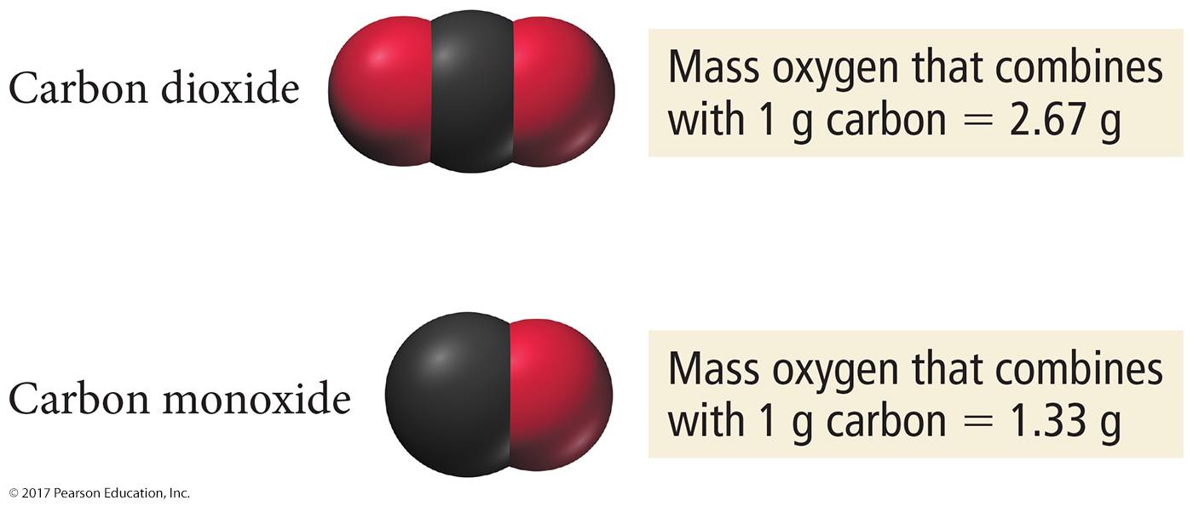
The Law of Multiple Proportions
The ratio of these two masses is itself a small whole number.

Slide 14
Subatomic Particles
All atoms are composed of the same subatomic particles:
  Protons
  Neutrons
  Electrons
Protons and neutrons, as we saw earlier, have nearly identical masses.
  The mass of the proton is 1.67262 × 10^{–27} kg.
  The mass of the neutron is 1.67493 × 10^{–27} kg.
  The mass of the electron is 0.00091 × 10^{–27} kg.

Slide 15
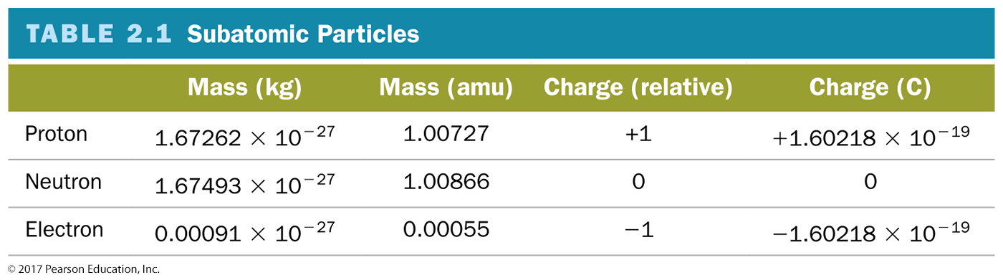
Subatomic Particles
The charge of the proton and the electron are equal in magnitude but opposite in sign. The neutron has no charge.

Slide 16
Elements: Defined by Their Numbers of Protons
The most important number to the identity of an atom is the number of protons in its nucleus.
The number of protons defines the element.
The number of protons in an atom’s nucleus is its atomic number and is given the symbol Z.

Slide 17
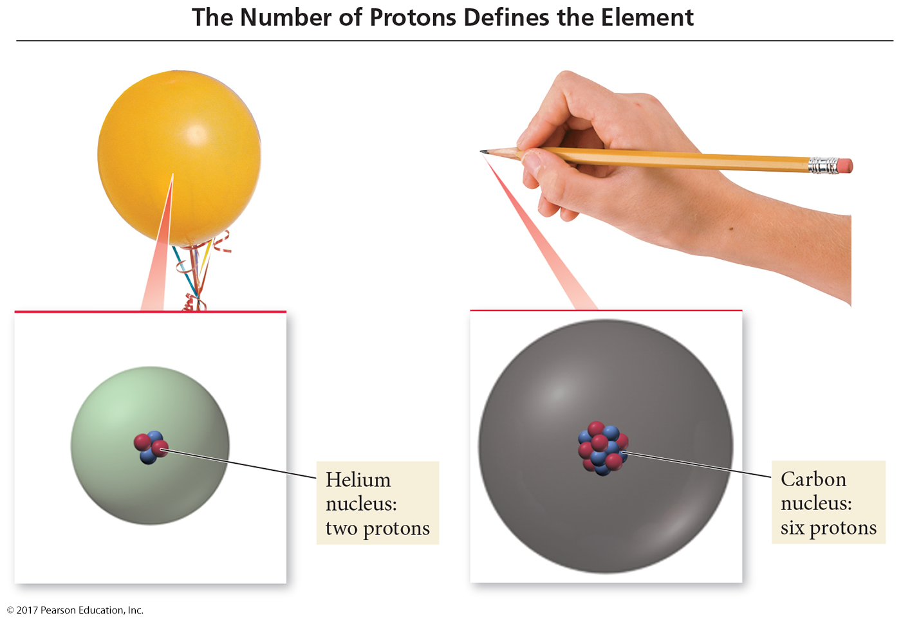
Elements: Defined by Their Numbers of Protons

Slide 18
Isotopes: Varied Number of Neutrons
All atoms of a given element have the same number of protons; however, they do not necessarily have the same number of neutrons.
    For example, all neon atoms contain 10 protons, but they may contain 10, 11, or 12 neutrons. All three types of neon atoms exist, and each has a slightly different mass.
Atoms with the same number of protons but a different number of neutrons are called isotopes.

Slide 19
Isotopes: Varied Number of Neutrons
The relative amount of each different isotope in a naturally occurring sample of a given element is roughly constant.
These percentages are called the natural abundance of the isotopes.
  Advances in mass spectrometry have allowed accurate measurements that reveal small but significant variations in the natural abundance of isotopes for many elements.

Slide 20
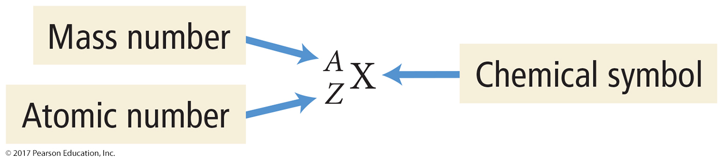

Isotopes: Varied Number of Neutrons
The sum of the number of neutrons and protons in an atom is its mass number and is represented by the symbol A.
A = number of protons (p) + number of neutrons (n)
  X is the chemical symbol, A is the mass number, and Z is the atomic number.

Slide 21
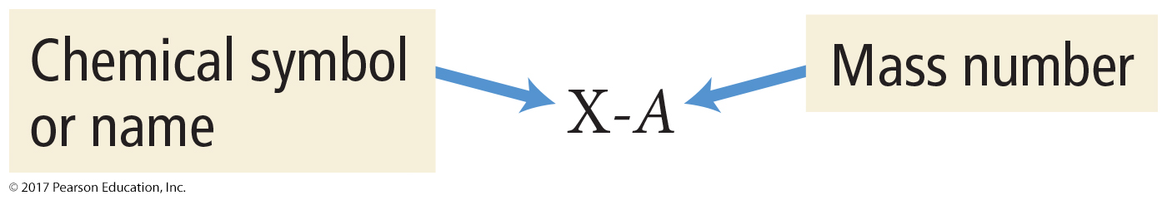

Isotopes: Varied Number of Neutrons
A second common notation for isotopes is the chemical symbol (or chemical name) followed by a dash and the mass number of the isotope.

Slide 22
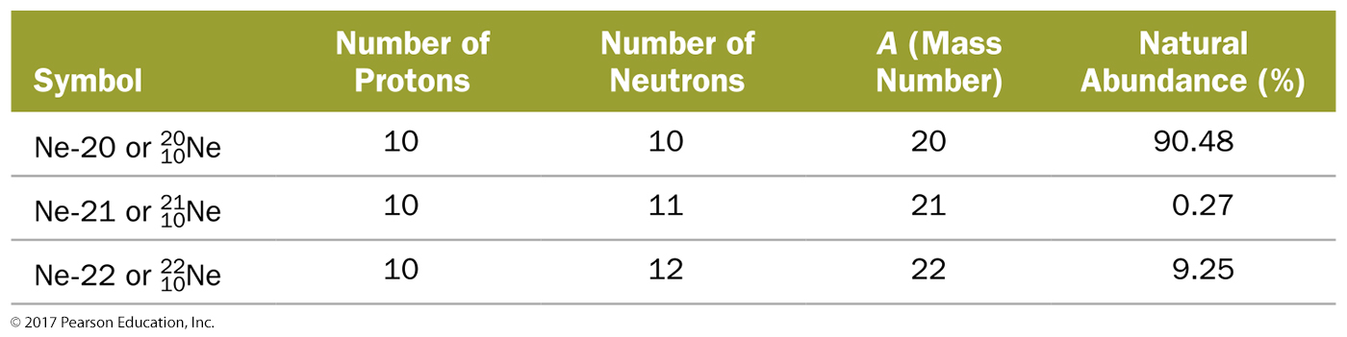
Isotopes: Varied Number of Neutrons

Slide 23
Ions: Losing and Gaining Electrons
The number of electrons in a neutral atom is equal to the number of protons in its nucleus (designated by its atomic number Z).
In a chemical change, however, atoms can lose or gain electrons and become charged particles called ions.
  Positively charged ions, such as Na⁺, are called cations.
  Negatively charged ions, such as F–, are called anions.

Slide 24
Finding Patterns: The Periodic Law and the Periodic Table
In 1869, Mendeleev noticed that certain groups of elements had similar properties.
He found that when elements are listed in order of increasing mass, these similar properties recurred in a periodic pattern.
  To be periodic means to exhibit a repeating pattern.

Slide 25
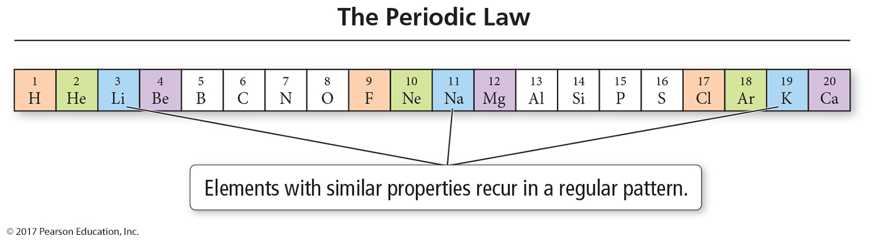
The Periodic Law
Mendeleev summarized these observations in the periodic law:
  When the elements are arranged in order of increasing mass, certain sets of properties recur periodically.

Slide 26
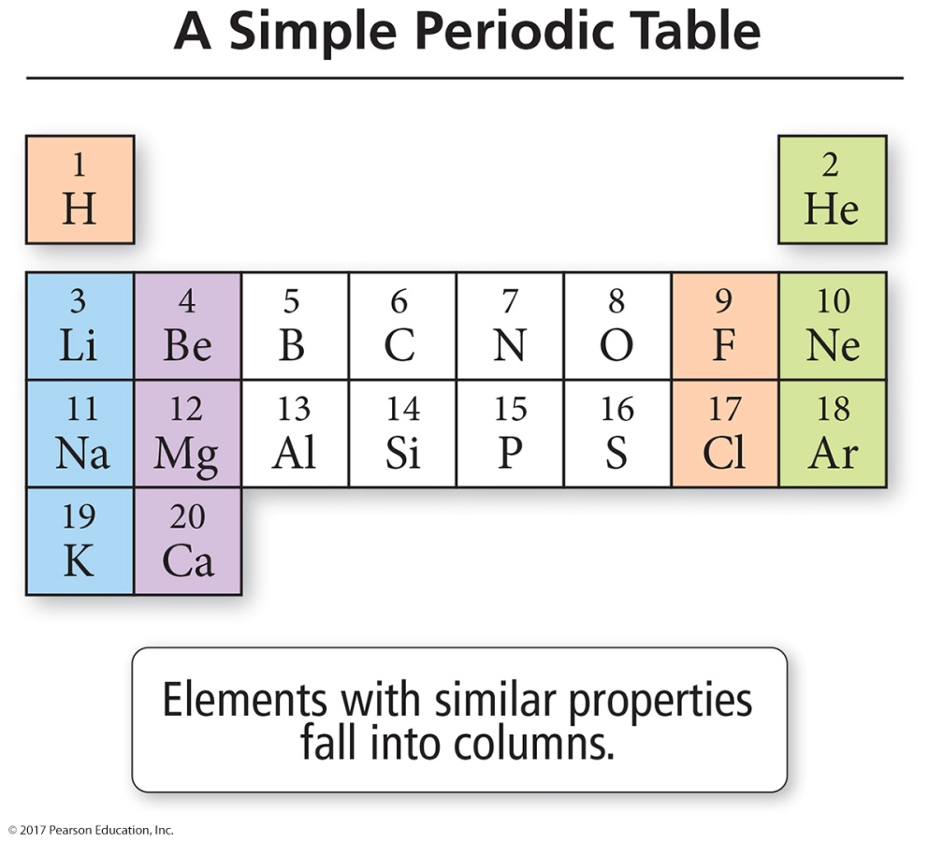
Periodic Table
Mendeleev organized the known elements in a table.
He arranged the rows so that elements with similar properties fall in the same vertical columns.

Slide 27
Periodic Table
Mendeleev’s table contained some gaps, which allowed him to predict the existence (and even the properties) of yet undiscovered elements.
  Mendeleev predicted the existence of an element he called eka-silicon.
  In 1886, eka-silicon was discovered by German chemist Clemens Winkler (1838–1904), who named it germanium.

Slide 28
Modern Periodic Table
In the modern table, elements are listed in order of increasing atomic number rather than increasing relative mass.
The modern periodic table also contains more elements than Mendeleev’s original table because more have been discovered since his time.

Slide 29
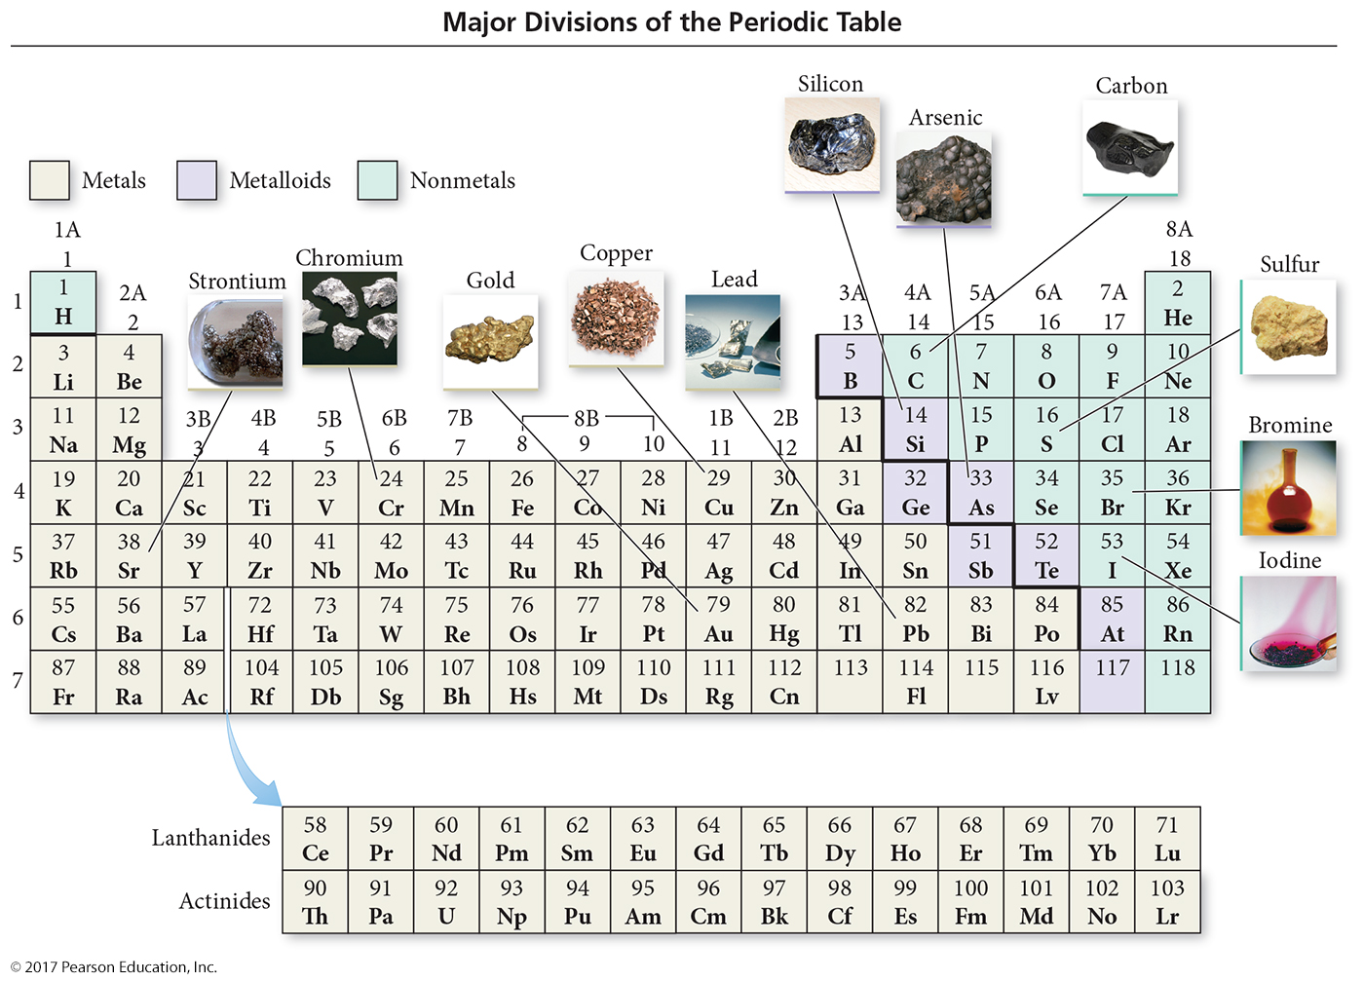
Modern Periodic Table

Slide 30
Classification of Elements
Elements in the periodic table are classified as the following:
      Metals
      Nonmetals
      Metalloids

Slide 31
Metals
Metals, on the lower-left side and middle of the periodic table, share some common properties.
    Good conductors of heat and electricity
    Can be pounded into flat sheets (malleability)
    Can be drawn into wires (ductility)
    Often shiny
    Tend to lose electrons when they undergo chemical changes
    Chromium, copper, strontium, and lead are typical metals.

Slide 32
Nonmetals
Nonmetals lie on the upper-right side of the periodic table.
There are a total of 17 nonmetals:
  Five are solids at room temperature (C, P, S, Se, and I).
  One is a liquid at room temperature (Br).
  Eleven are gases at room temperature (H, He, N, O, F, Ne, Cl, Ar, Kr, Xe, and Rn).

Slide 33
Nonmetals
Nonmetals as a whole tend to have these properties:
  Poor conductors of heat and electricity
  Not ductile and not malleable
  Gain electrons when they undergo chemical changes
Oxygen, carbon, sulfur, bromine, and iodine are nonmetals.

Slide 34
Metalloids
Metalloids are sometimes called semimetals.
They are elements that lie along the zigzag diagonal line that divides metals and nonmetals.
They exhibit mixed properties.
Several metalloids are also classified as semiconductors because of their intermediate (and highly temperature-dependent) electrical conductivity.

Slide 35
Periodic Table
The periodic table can also be divided into
  main-group elements, whose properties tend to be largely predictable based on their position in the periodic table.
  transition elements or transition metals, whose properties tend to be less predictable based simply on their position in the
  periodic table.

Slide 36
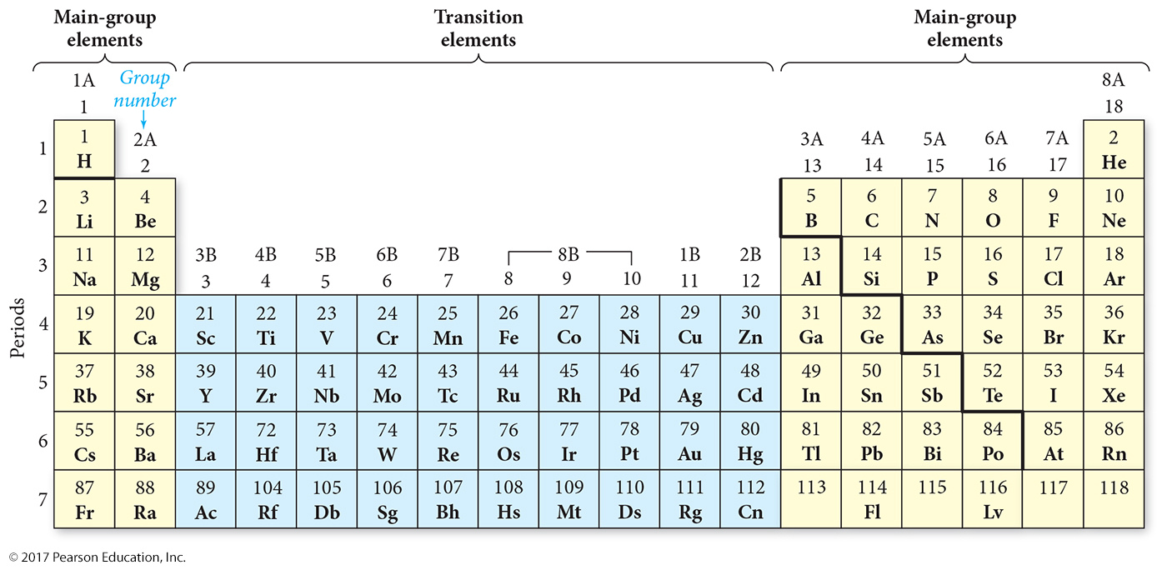
Periodic Table

Slide 37
Periodic Table
The periodic table is divided into vertical columns and horizontal rows.
  Each vertical column is called a group (or family).
  Each horizontal row is called a period.
There are a total of 18 groups and 7 periods.
The groups are numbered 1–18 (or the A and B grouping).

Slide 38
Periodic Table
Main-group elements are in columns labeled with a number and the letter A (1A–8A or groups 1, 2, and 13–18).
Transition elements are in columns labeled with a number and the letter B (or groups 3–12).

Slide 39
Ions and the Periodic Table
A main-group metal tends to lose electrons, forming a cation with the same number of electrons as the nearest noble gas.
A main-group nonmetal tends to gain electrons, forming an anion with the same number of electrons as the nearest noble gas.

Slide 40
Ions and the Periodic Table
In general, the alkali metals (group 1A) have a tendency to lose one electron and form 1+ ions.
The alkaline earth metals (group 2A) tend to lose two electrons and form 2+ ions.
The halogens (group 7A) tend to gain one electron and form 1– ions.
The oxygen family nonmetals (group 6A) tend to gain two electrons and form 2– ions.

Slide 41
Ions and the Periodic Table
For the main-group elements that form cations with a predictable charge, the charge is equal to the group number.
For main-group elements that form anions with a predictable charge, the charge is equal to the group number minus eight.
Transition elements may form various different ions with different charges.

Slide 42
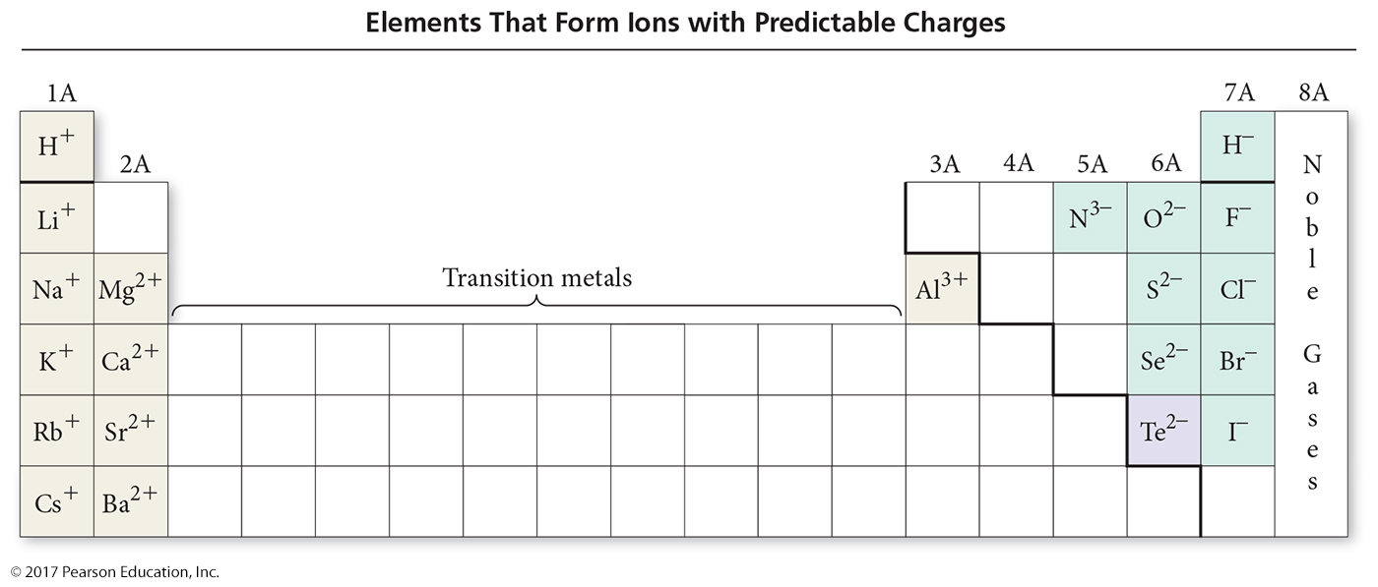
Ions and the Periodic Table

Slide 43
Atomic Mass: The Average Mass of an Element’s Atoms
Atomic mass is sometimes called atomic weight or standard atomic weight.
The atomic mass of each element is directly beneath the element’s symbol in the periodic table.
It represents the average mass of the isotopes that compose that element, weighted according to the natural abundance of each isotope.

Slide 44
Example: Atomic Mass
Naturally occurring chlorine consists of 75.77% chlorine-35 atoms (mass 34.97 amu) and 24.23% chlorine-37 atoms (mass 36.97 amu). Calculate its atomic mass.
Solution:
  Convert the percent abundance to decimal form and multiply each with its isotopic mass.
    Cl-37 = 0.2423(36.97 amu) = 8.9578 amu
    Cl-35 = 0.7577(34.97 amu) = 26.4968 amu
    Atomic Mass Cl = 8.9578 + 26.4968 = 35.45 amu

Slide 45
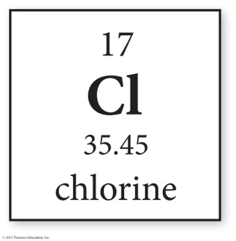
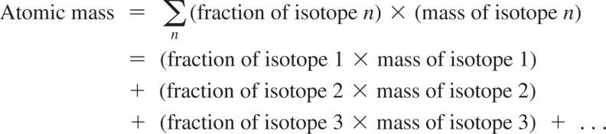
Atomic Mass
In general, we calculate the atomic mass with the following equation:

Slide 46

Converting between Number of Moles and Number of Atoms
Converting between number of moles and number of atoms is similar to converting between dozens of eggs and number of eggs.
For atoms, you use the conversion factor
1 mol atoms = 6.022 × 10²³ atoms.
The conversion factors take the following forms:

Slide 47
Converting between Mass and Amount (Number of Moles)
To count atoms by weighing them, we need one other conversion factor—the mass of
1 mol of atoms.
The mass of 1 mol of atoms of an element is the molar mass.
An element’s molar mass in grams per mole is numerically equal to the element’s atomic mass in atomic mass units (amu).

Slide 48
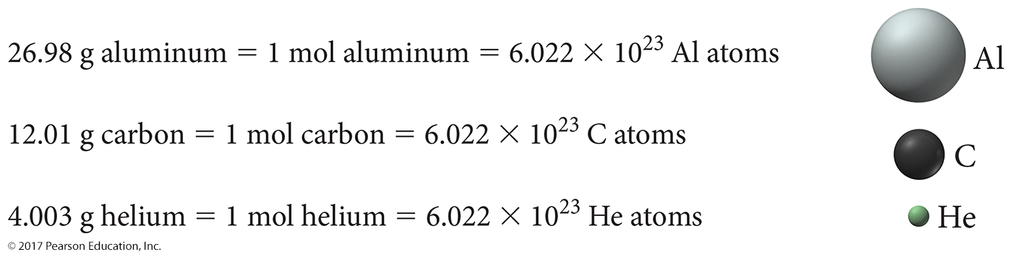
Converting between Mass and Moles
The lighter the atom, the less mass in 1 mol of atoms.

Slide 49

Converting between Mass and Moles
The molar mass of any element is the conversion factor between the mass (in grams) of that element and the amount (in moles) of that element. For carbon,

Slide 50
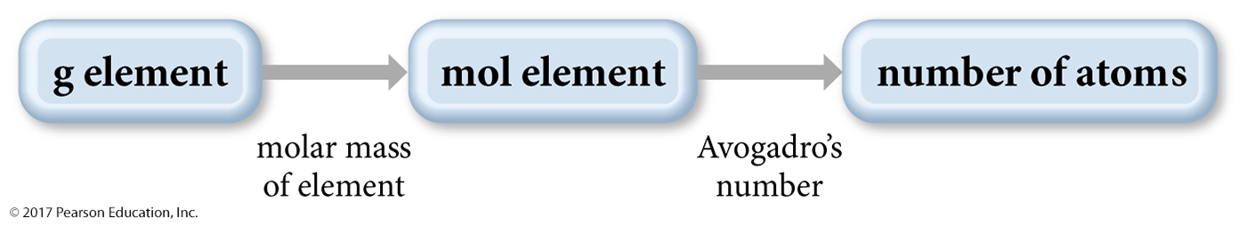
Conceptual Plan
We now have all the tools to count the number of atoms in a sample of an element by weighing it.
    First, we obtain the mass of the sample.
    Then, we convert it to the amount in moles using the element’s molar mass.
    Finally, we convert it to the number of atoms using Avogadro’s number.
The conceptual plan for these kinds of calculations takes the following form:

