Slide 1

Lecture Presentation
Chapter 1
Matter, Measurement,
and Problem Solving

Slide 2
Atoms and Molecules
Atoms and molecules determine how matter behaves; if they were different, matter would be different.
  The properties of water molecules determine how water behaves; the properties of sugar molecules determine how sugar behaves.
The understanding of matter at the molecular level gives us unprecedented control over that matter.

Slide 3
Atoms and Molecules
Atoms are the submicroscopic particles that constitute the fundamental building blocks of ordinary matter.
Free atoms are rare in nature; instead they bind together in specific geometrical arrangements to form molecules.

Slide 4
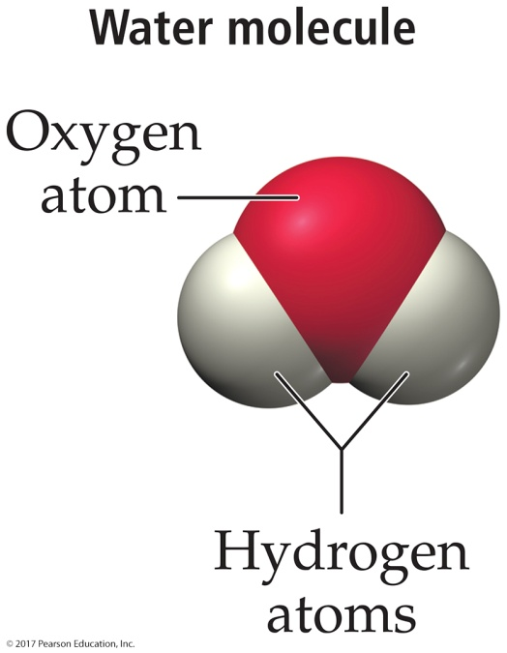
Atoms and Molecules
Liquid water is composed of water molecules.
Each molecule contains two hydrogen atoms and an oxygen atom held together by a chemical bond.

Slide 5
The Scientific Approach to Knowledge
The approach to scientific knowledge is empirical—it is based on observation and experiment.
The scientific method is a process for understanding nature by observing nature and its behavior, and by conducting experiments to test our ideas.
Key characteristics of the scientific method include observation, formulation of hypotheses, experimentation, and formulation of laws and theories.

Slide 6
Observations
Observations are also known as data.
They are the descriptions about the characteristics or behavior of nature.
  Antoine Lavoisier (1743–1794) noticed that there was no change in the total mass of material within the container during combustion.
Observations often lead scientists to formulate a hypothesis.

Slide 7
Hypothesis
A hypothesis is a tentative interpretation or explanation of the observations.
  For example, Lavoisier explained his observations on combustion by hypothesizing that when a substance burns, it combines with a component of air.
A good hypothesis is falsifiable.
  The results of an experiment may support a hypothesis or prove it wrong, in which case the scientist must modify or discard the hypothesis.

Slide 8
A Scientific Law
A brief statement that summarizes past observations and predicts future ones.
  Law of conservation of mass—“In a chemical reaction, matter is neither created nor destroyed.”
Allows you to predict future observations.
  So you can test the law with experiments
Unlike civil or governmental laws, you cannot choose to violate a scientific law.

Slide 9
Theory
One or more well-established hypotheses may form the basis for a scientific theory.
A scientific theory is a model for the way nature is and tries to explain not merely what nature does, but why.
Theories are validated by experiments.
Theories can never be conclusively proven because some new observation or experiment always has the potential to reveal a flaw.

Slide 10
Theory
General explanation for the characteristics and behavior of nature
Models of nature
  Dalton’s atomic theory-states that all matter is made of atoms which defines properties of matter (conservation, balanced equations, etc.)
Can be used to predict future observations
  So they can be tested by experiments

Slide 11
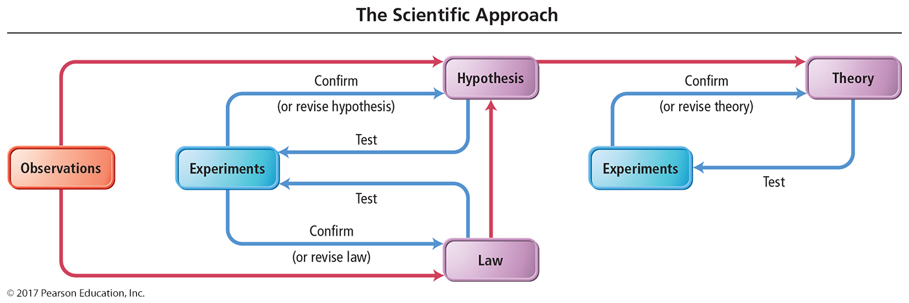
The Scientific Approach to Knowledge

Slide 12
Conceptual Connection 1.1
Which statement best explains the difference between a law and a theory?
(a) A law is truth; a theory is a mere speculation.
A law summarizes a series of related observations; a theory gives the underlying reasons for them.
(c) A theory describes what nature does; a law describes why nature does it.

Slide 13
Conceptual Connection 1.1
Which statement best explains the difference between a law and a theory?
A law is truth; a theory is a mere speculation.
A law summarizes a series of related observations; a theory gives the underlying reasons for them.
A theory describes what nature does; a law describes why nature does it.

Slide 14
The Classification of Matter
Matter is anything that occupies space and
has mass.
  Your textbook, your desk, your chair, and even your body are all composed of matter.
We can classify matter according to its state (its physical form) and its composition (the basic components that make it up).

Slide 15
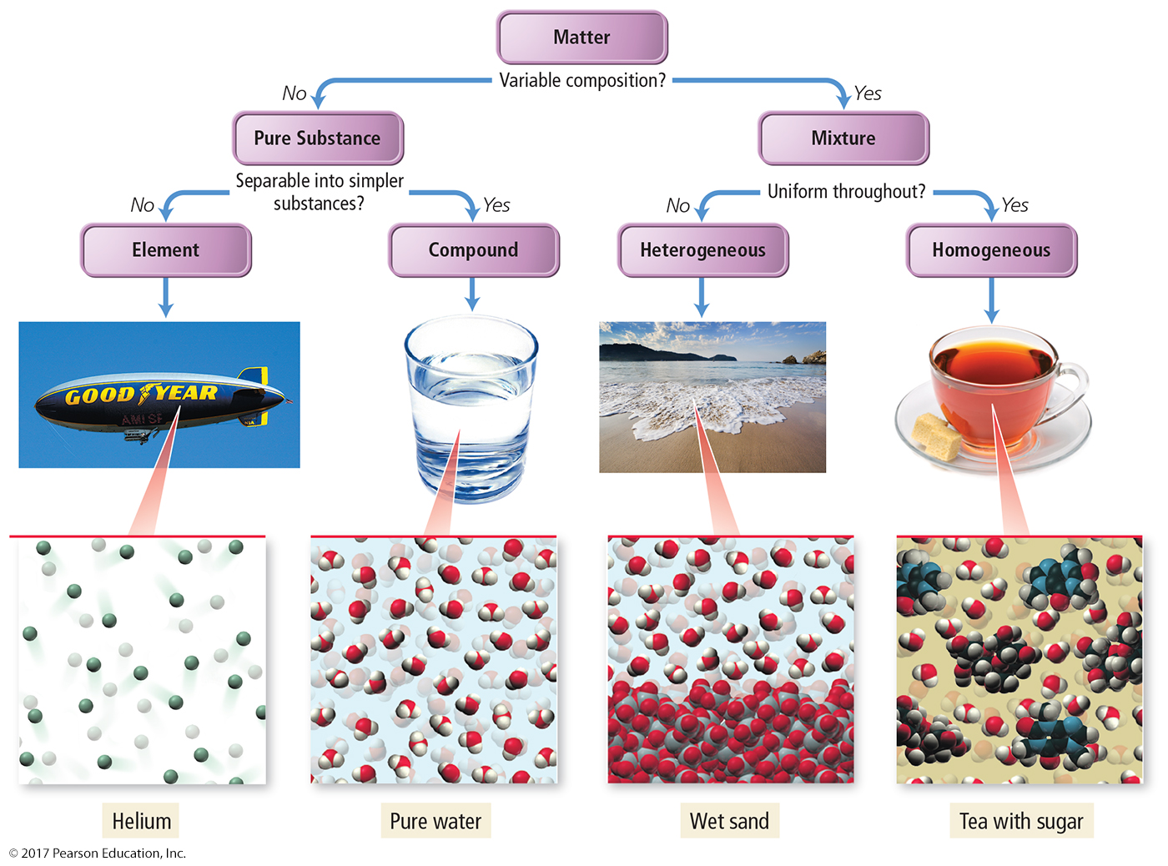
The Classification of Matter by Components
Matter can also be classified according to its composition: elements, compounds, and mixtures.

Slide 16
Classification of Matter by Components
The first division in the classification of matter is between a pure substance and a mixture.
A pure substance is made up of only one component, and its composition is invariant.
A mixture, by contrast, is a substance composed of two or more components in proportions that can vary from one sample to another.

Slide 17
Classification of Pure Substances
There are two types of pure substances.
  Elements
  Compounds
This categorization depends on whether or not they can be broken down (or decomposed) into simpler substances.

Slide 18
Classification of Pure Substances
An element is a substance that cannot be chemically broken down into simpler substances.
  Basic building blocks of matter
  Composed of single type of atom, like helium
A compound is a substance composed of two or more elements in fixed definite proportions.
Most elements are chemically reactive and combine with other elements to form compounds like water, sugar, etc.

Slide 19
Classification of Mixtures
Mixtures can be categorized into two types:
  Heterogeneous mixtures
  Homogeneous mixtures
This categorization of mixture depends on how uniformly the substances within them mix.

Slide 20
Heterogeneous Mixture
A heterogeneous mixture is one in which the composition varies from one region of the mixture to another.
  Made of multiple substances whose presences can be seen
  Example: a salt and sand mixture
    Portions of a sample of heterogeneous mixture have different composition and properties.

Slide 21
Homogeneous Mixture
A homogeneous mixture is one made of multiple substances but appears to be one substance.
All portions of a sample have the same composition and properties (like sweetened tea).
Homogeneous mixtures have uniform compositions because the atoms or molecules that compose them mix uniformly.

Slide 22
Physical and Chemical Changes
Physical Change:
Changes that alter only the state or appearance of a substance, but not composition, are physical changes.
The atoms or molecules that compose a substance do not change their identity during a physical change.

Slide 23
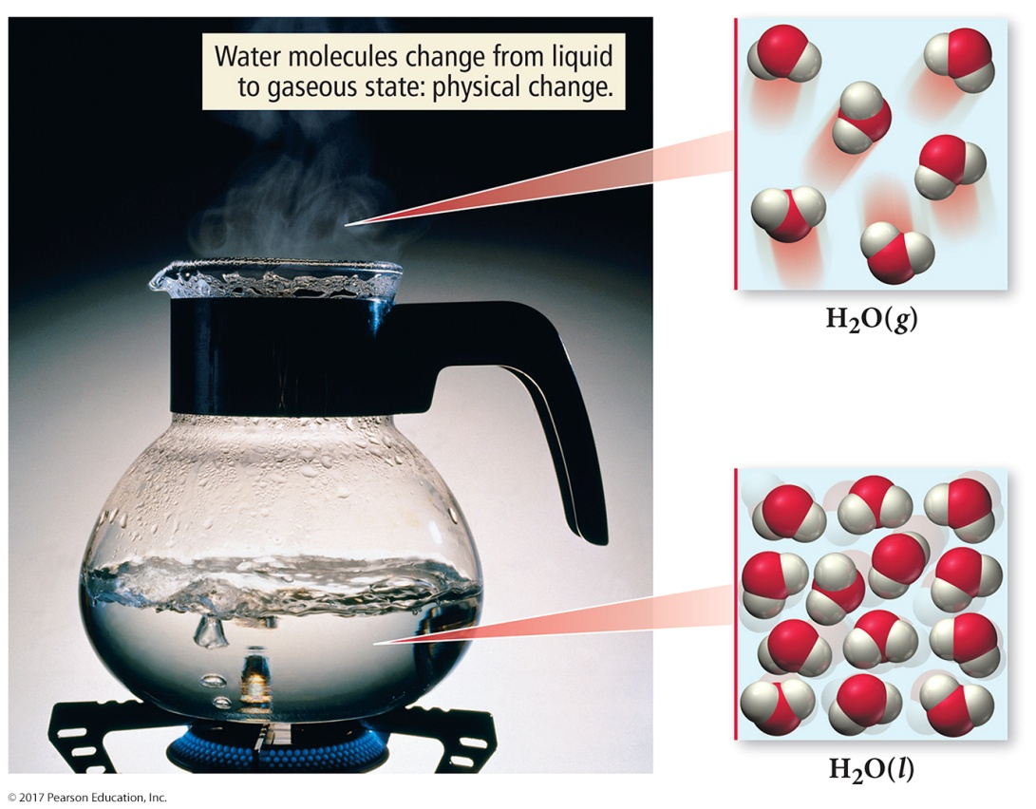
Physical Change
When water boils, it changes its state from a liquid to
a gas.
The gas remains composed of water molecules, so this is a physical change.

Slide 24
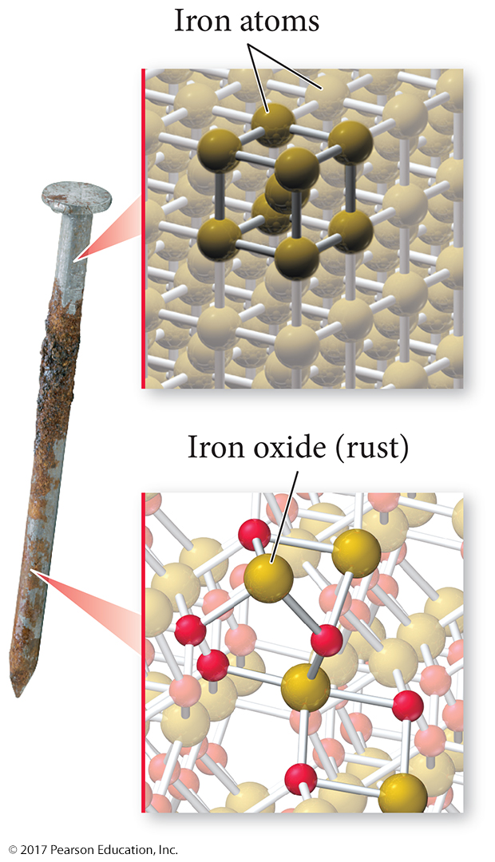
Chemical Change
Changes that alter the composition of matter are chemical changes.
During a chemical change, atoms rearrange, transforming the original substances into different substances.
Rusting of iron is a chemical change.

Slide 25
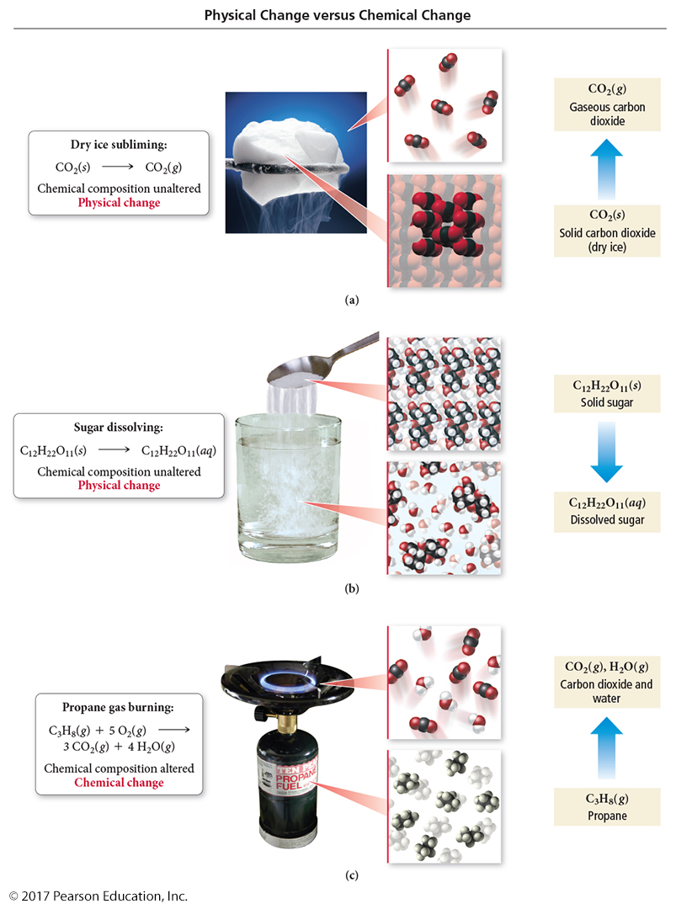
Physical and Chemical Changes

Slide 26
Physical and Chemical Properties
A physical property is a property that a substance displays without changing its composition.
  The smell of gasoline is a physical property.
  Odor, taste, color, appearance, melting point, boiling point, and density are all physical properties.
A chemical property
is a property that a substance displays
only by changing its composition via a chemical change (or chemical reaction).
  The flammability of gasoline, in contrast, is a chemical property.
  Chemical properties include corrosiveness, acidity, and toxicity.

Slide 27
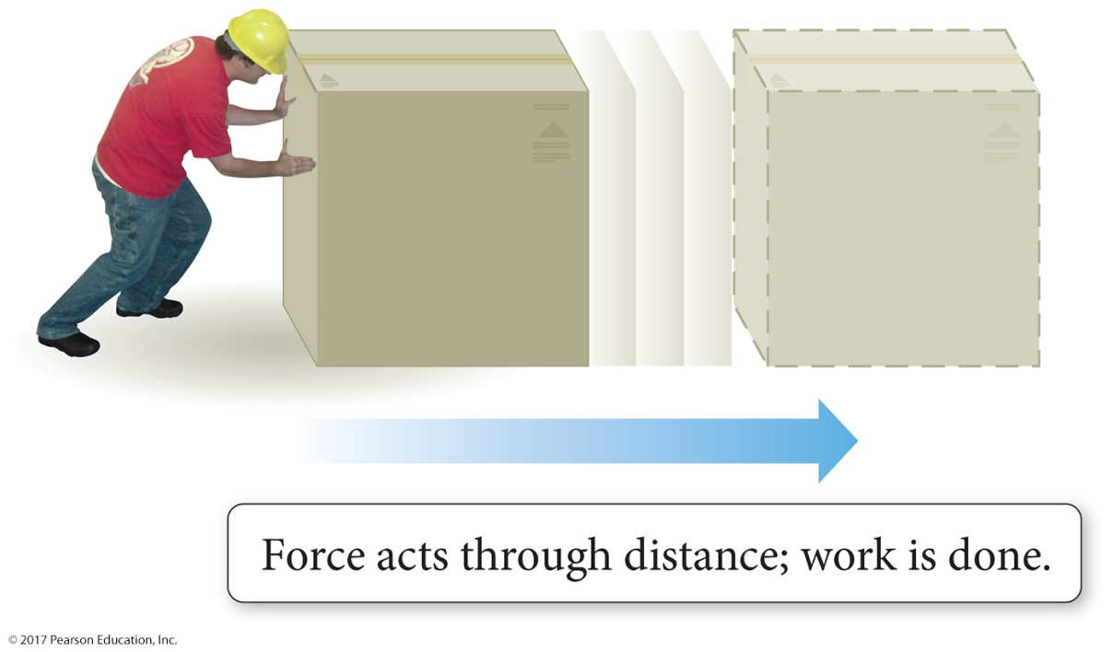
Energy: A Fundamental Part of Physical and Chemical Change
Energy is the capacity to do work.
Work is defined as the action of a force through a distance.
When you push a box across the floor or pedal your bicycle across the street, you have done work.

Slide 28
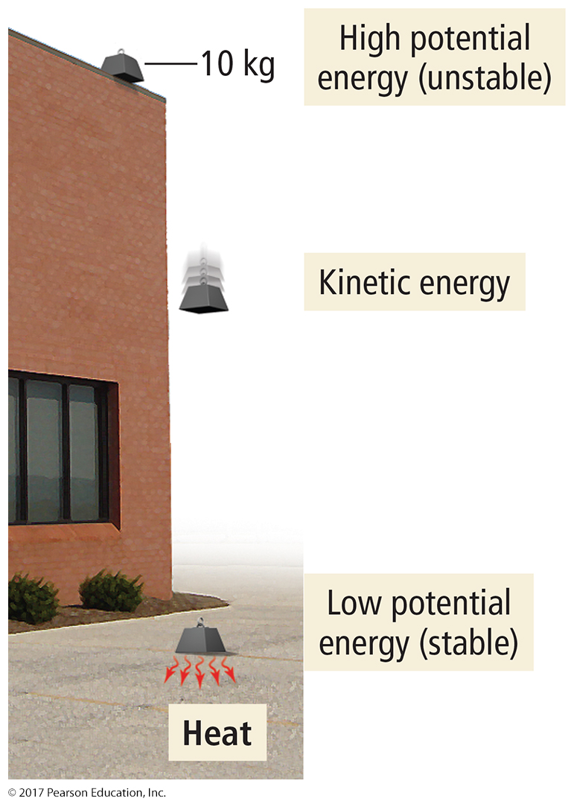
Energy
Kinetic energy is the energy associated with the motion of
an object.
Potential energy is the energy associated with the position or composition of an object.
Thermal energy is the energy associated with the temperature of an object.
  Thermal energy is actually a type of kinetic energy because it arises from the motion of the individual atoms or molecules that make up an object.

Slide 29
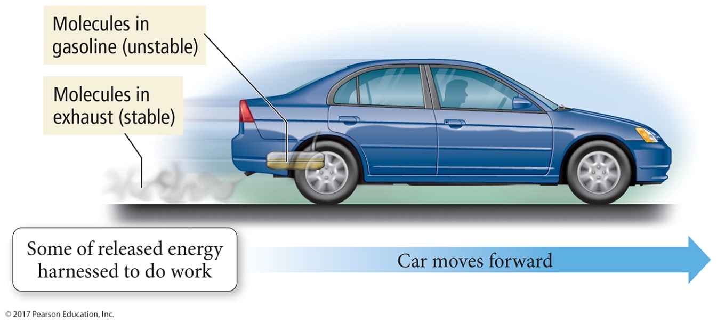
Summarizing Energy
Energy is always conserved in a physical or chemical change; it is neither created nor destroyed (law of conservation of energy).
KEY CONCEPT!!! Systems with high potential energy tend to change in a direction that lowers their potential energy, releasing energy into the surroundings.

Slide 30
The Units of Measurement
In chemistry, units—standard quantities used to specify measurements—are critical.
The two most common unit systems are as follows:
  Metric system, used in most of the world
  English system, used in the United States
Scientists use the International System of Units (SI), which is based on the metric system.
  The abbreviation SI comes from the French, phrase Système International d’ Unités.

Slide 31
The Kelvin: A Measure of Temperature
The kelvin (K) is the SI unit of temperature.
The temperature is a measure of the average amount of kinetic energy of the atoms or molecules that compose the matter.
Temperature also determines the direction of thermal energy transfer, or what we commonly call heat.
Thermal energy transfers from hot to cold objects.

Slide 32
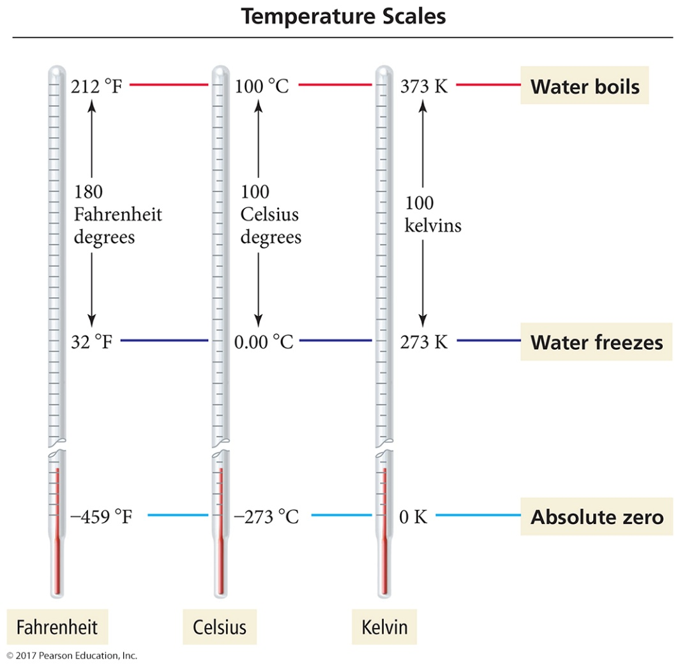
The Kelvin: A Measure of Temperature
Kelvin scale (absolute scale) assigns 0 K (absolute zero) to the coldest temperature possible.
Absolute zero (–273 °C or –459 °F) is the temperature at which molecular motion virtually stops. Lower temperatures do
not exist.

Slide 33
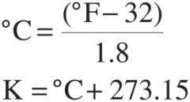
A Measure of Temperature
The Fahrenheit degree is five-ninths the size of a Celsius degree.
The Celsius degree and the Kelvin degree are the same size.
Temperature scale conversion is done with these formulas:

Slide 34
Prefix Multipliers
The International System of Units uses the prefix multipliers shown in Table 1.2 with the standard units.
These multipliers change the value of the unit by the powers of 10 (just like an exponent does in scientific notation).
For example, the kilometer has the prefix kilo meaning 1000 or 10³.

Slide 35
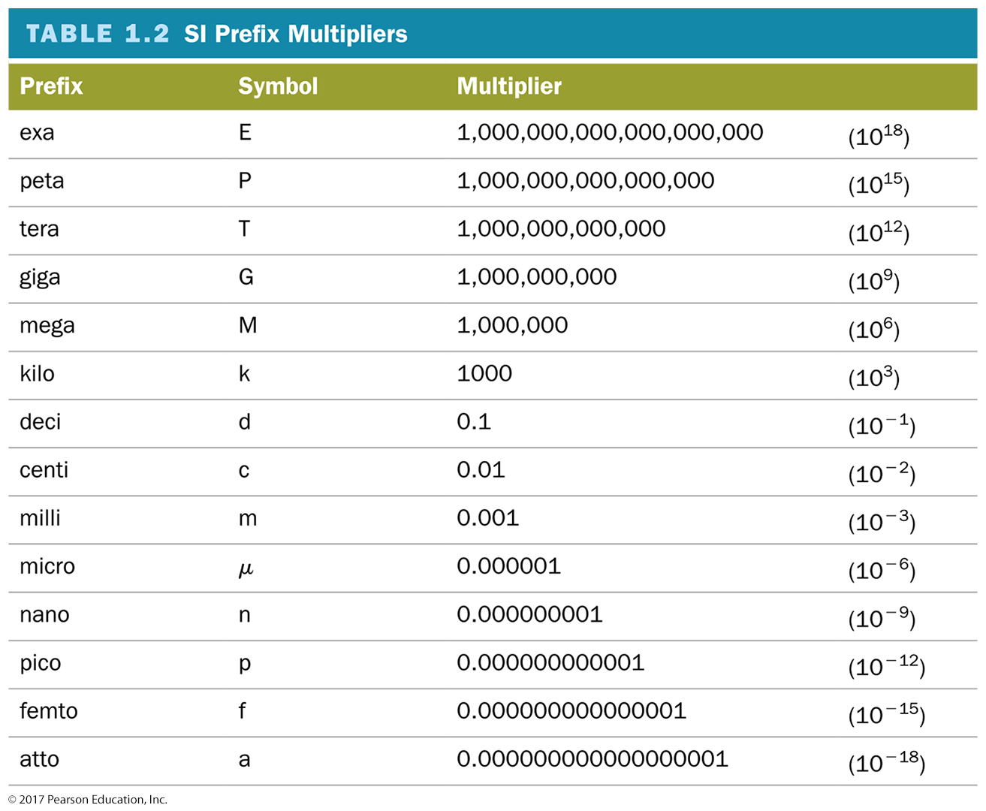
Prefix Multipliers

Slide 36
Derived Units: Volume and Density
Derived unit is a combination of other units.
Volume is a measure of space; it has units of length cubed (i.e., cm³) or liters (L).
Density is the ratio of a substance’s mass to volume; it has units of mass/volume.
Density affects if a substance will sink or float in another. The less dense substance floats.

Slide 37
Intensive and Extensive Properties
An intensive property is a characteristic that is independent of the amount of substance.
  Density is an intensive property.
An extensive property is a characteristic that is dependent on the amount of substance.
  Mass is an extensive property.

Slide 38
Counting Significant Figures
Significant figures deal with writing numbers to reflect precision.
The precision of a measurement depends on the instrument used to make the measurement.
The preservation of this precision during calculations can be accomplished by using significant figures.

Slide 39
Counting Significant Figures
The greater the number of significant figures, the greater the certainty of the measurement.
To determine the number of significant figures in a number, follow these rules (examples are on the right).
Significant Figure Rules Examples
1. All nonzero digits are significant. 28.03 0.0540
2. Interior zeroes (zeroes between two 408 7.0301
nonzero digits) are significant.

Slide 40
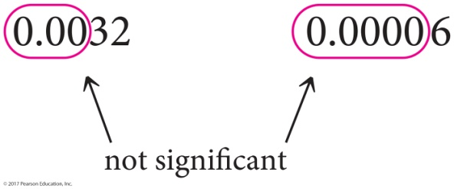
Counting Significant Figures
Significant Figure Rules
3. Leading zeroes (zeroes to the left of the first nonzero digit) are not significant. They only serve to locate the decimal point.
4. Trailing zeroes (zeroes at the end of a number) are categorized as follows:
Trailing zeroes after a decimal point are always significant.
Trailing zeroes before a decimal point (and after a nonzero number) are always significant.
Trailing zeroes before an implied decimal point are ambiguous and should be avoided by using scientific notation.
Decimal points are placed after one or more trailing zeroes if the zeroes are to be considered significant.
Examples
45.000 3.5600
140.00 2500.55
1200 Ambiguous
1.2 × 10³ 2 significant figures
1.20 × 10³ 3 significant figures
1.200 × 10³ 4 significant figures
1200. 4 significant figures

Slide 41
Exact Numbers
Exact numbers have an unlimited number of significant figures.
  Exact counting of discrete objects
  Integral numbers that are part of an equation
  Defined quantities
Some conversion factors are defined quantities, while others are not.

Slide 42
Significant Figures in Calculations
In calculations using measured quantities, the results of the calculation must reflect the precision of the measured quantities.
We should not lose or gain precision during mathematical operations.

Slide 43
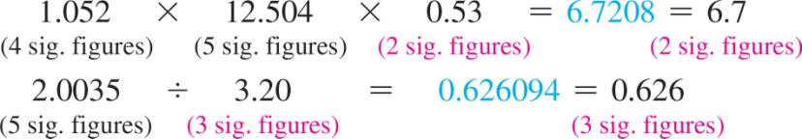
Significant Figures: Rules for Calculations
Multiplication and Division Rule:
In multiplication or division, the result carries the same number of significant figures as the factor with the fewest significant figures.

Slide 44
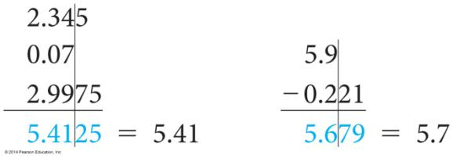
Rules for Calculations
Addition and Subtraction Rule:
In addition or subtraction the result carries the same number of decimal places as the quantity with the fewest decimal places.
It is helpful to draw a line next to the number with the fewest decimal places. This line determines the number of decimal places in the answer.

Slide 45
Rules for Calculations
Rules for Rounding:
When rounding to the correct number of significant figures,
  round down if the last (or leftmost) digit dropped is four or less;
  round up if the last (or leftmost) digit dropped is five
  or more.

Slide 46
Rules for Rounding
Rounding to two significant figures:
5.37 rounds to 5.4
5.34 rounds to 5.3
5.35 rounds to 5.4
5.349 rounds to 5.3
Notice in the last example that only the last (or leftmost) digit being dropped determines in which direction to round—ignore all digits to the right of it.

Slide 47
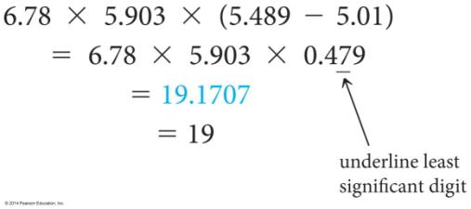
Rounding in Multistep Calculations
To avoid rounding errors in multistep calculations round only the final answer.
Do not round intermediate steps. If you write down intermediate answers, keep track of significant figures by underlining the least significant digit.

Slide 48
Precision and Accuracy
Accuracy refers to how close the measured value is to the actual value.
Precision refers to how close a series of measurements are to one another or how reproducible they are.

Slide 49
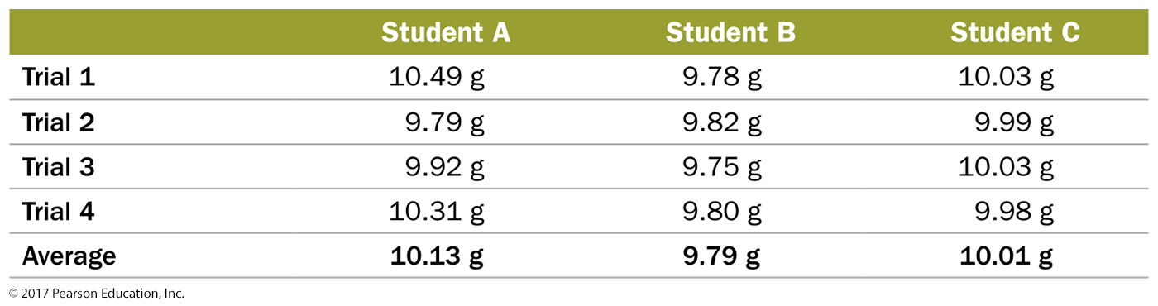
Precision and Accuracy
Consider the results of three students who repeatedly weighed a lead block known to have a true mass of 10.00 g (indicated by the solid horizontal blue line on the graphs).

Slide 50
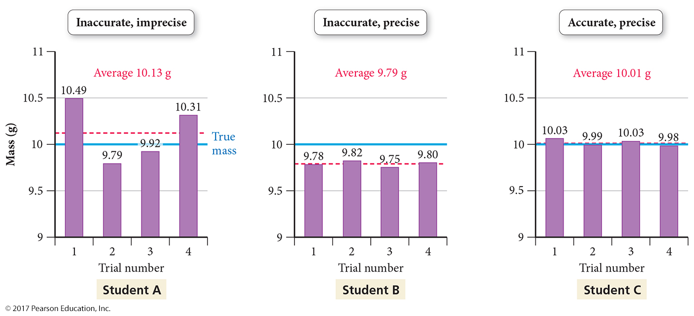
Precision and Accuracy (continued)
Measurements are said to be
  precise if they are consistent with one another.
  accurate only if they are close to the actual value.

Slide 51
Precision and Accuracy (continued)
The results of student A are both inaccurate (not close to the true value) and imprecise (not consistent with one another).
  Random error is an error that has the equal probability of being too high or too low.
The results of student B are precise (close to one another in value) but inaccurate.
  Systematic error is an error that tends toward being either too high or too low.
The results of student C display little systematic error or random error—they are both accurate and precise.

Slide 52
Solving Chemical Problems
Most chemistry problems you will solve in this course are unit conversion problems.
Using units as a guide to solving problems is called dimensional analysis.
Units should always be included in calculations; they are multiplied, divided, and canceled like any other algebraic quantity.

Slide 53
Dimensional Analysis
A unit equation is a statement of two equivalent quantities, such as
2.54 cm = 1 in.
A conversion factor is a fractional quantity of a unit equation with the units we are converting from on the bottom and the units we are converting to on the top.

Slide 54
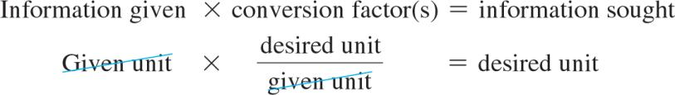
Dimensional Analysis
Most unit conversion problems take the
following form:

Slide 55
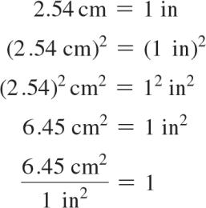
Dimensional Analysis
Units Raised to a Power:
When building conversion factors for units raised to a power, remember to raise both the number and the unit to the power. For example, to convert from in² to cm², we construct the conversion factor as follows:

